Slide 1
Co-design in the GOOS Ocean Decade Programmes
Emma Heslop, Programme Manager GOOS Office, IOC/UNESCO
Programme Leads - David Legler, NOAA; Sabrina Speich IPSL; Molly Powers SPC; Alvaro Scadilli, Argentina Navy; Nadia Pinardi UNIBO; Villy Kourafalou UoM; Joaquìn Tintoré SOCIB
Support - Ann-Christine Zinkann, NOAA; Mairéad O’Donovan, GOOS, Andrea McCurdy, NASA
Endorsed by the UN Decade of Ocean Science

Slide 2
GOOS at the heart of the Ocean Decade
Ocean Observing Co-Design Transforming our ocean observing system assessment and design processes
CoastPredict
Revolutionising Global Coastal Ocean observing and forecasting
Observing Together
Connecting ocean observers and the communities they serve to transform ocean data access and availability
11 endorsed Ocean Decade projects
First Workshop June to develop use area ‘exemplars’ projects , 250+
6 Focus Areas. 5 endorsed projects, some ‘core’ projects, some funded, more planned. 64 partners in the SC.
5 endorsed projects Ocean Observing Report Card

Slide 3
Ocean Observing Co-Design will develop a more user-focused co-design process to evolve a truly integrated, responsive ocean observing system.
Notes:
This statement sums up the ambition of the Ocean Observing Co-Design programme. By 2030 we want to have processes and tools that will be modular and globally applicable to evaluate observing systems in order to inform investment. Sponsors will be able to ask key questions about cost and benefit and receive clear answers.

Slide 4
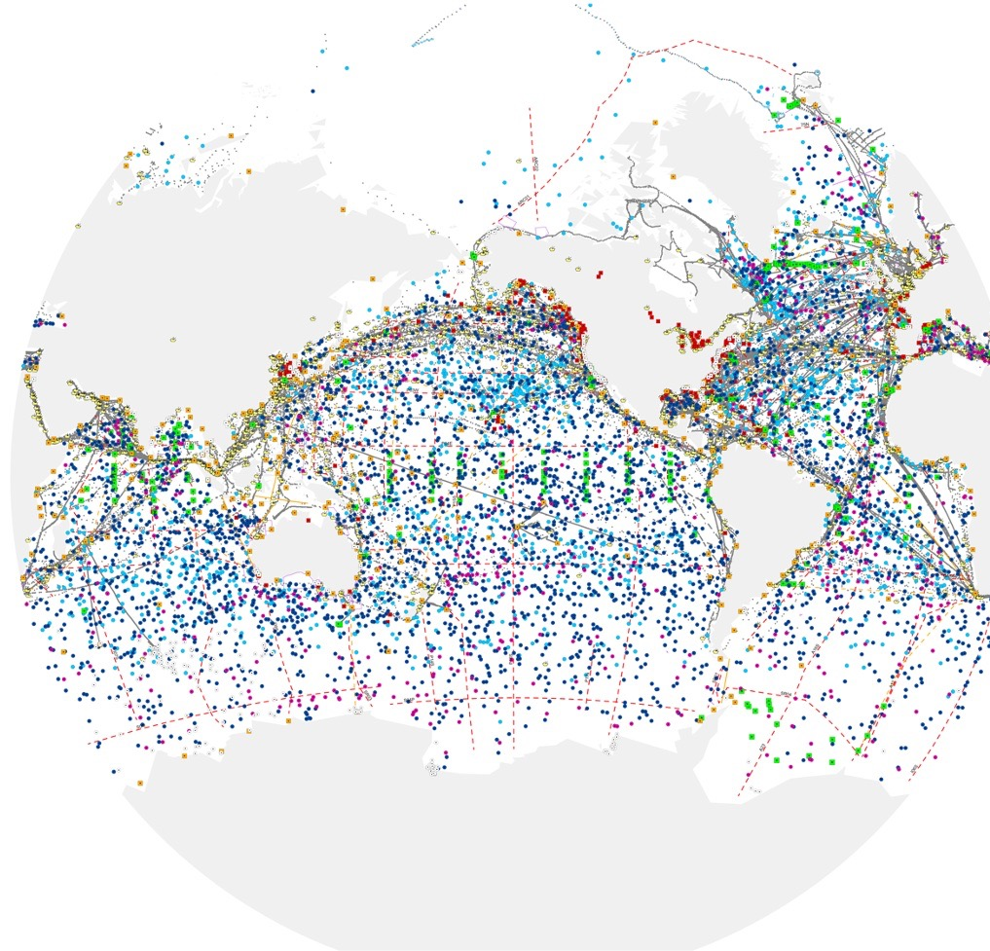
Ocean Observing Co-Design Programme objectives
1.
2.
Provide national government funders the information needed to target investment globally, regionally and locally.
Make ocean observing and information more accessible and impactful.
3.
4.
Develop system diagnostics, tools and reporting capability to better assess fitness-for-purpose across evolving requirements and use-inspired needs.
Establish international capacity and infrastructure to co-design and regularly evaluate the observing system at different scales by a centre of excellence.
Notes:
Engagement across obs-modeling communities and even some downstream stakeholders
Emerging potential set of “best practices” for co-design process.
Develop strong benefit statement (supported through economic impact analysis where possible)
Mapping: stakeholders and characterise interactions / users / regions / OSSEs

Slide 5
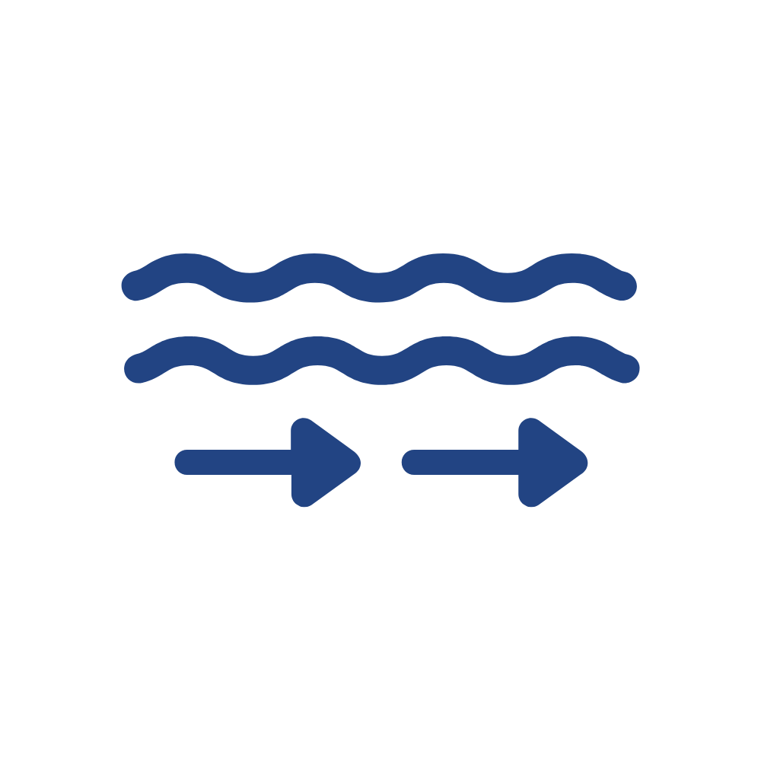
Ocean Observing Co-Design
Improving carbon data
Advancing cyclone forecasting
Sustaining development and conservation of living marine resources –
Linked MarineLife 2030
Improving storm surge predictions
- Linked to CoastPredict
Monitoring marine heatwave impacts on biodiversity and economies
– Linked to EuroSea work
Observing key current systems
Commit leadership, financial and technical resources to
lift the observing system in key areas
Notes:
Build on existing efforts and lessons learnt
Address key gaps in an integrated manner - spanning modelling/observing satellite and in-situ/services/users
Encourage involvement, alignment, actively participate
First co-design exemplar proposals Sept 2022

Slide 6
Exemplars – how they work
CO-DESIGN: a continuous, collaborative, iterative process involving all stakeholders - observing system implementers, data managers, modeling/assessment, service providers & / or users
Exemplars:
> focus on specific user groups > map value chain & evaluate existing connections to identify appropriate level of ‘user’ to participate in co-design
> elevate collaboration with existing elements of the value-chain i.e.
ocean observing system components / modelling / services > co-develop observing system design, assess Return On Investment > develop recommendations for addressing gaps in the value-chain
Develop best practices
Implement recommendations as part of GOOS infrastructure
tools that track, evaluate, and communicate recommendations
Points for interaction:
Contribute to Exemplar project implementation
Pilot area for implementation

Slide 7
SHAREMED
CO-DESIGN
addressing common and emerging challenges on marine environmental threats in the Mediterranean
shared, effective observing systems needed to monitor these
endeavours also target non-EU countries in the region
governance towards enhanced coordination
Contribute to Exemplar Projects
Pilot area for implementation
Suggest new exemplars
Observing Together projects - capacity building
Coast Predict - uplift coastal prediction and services

Slide 8
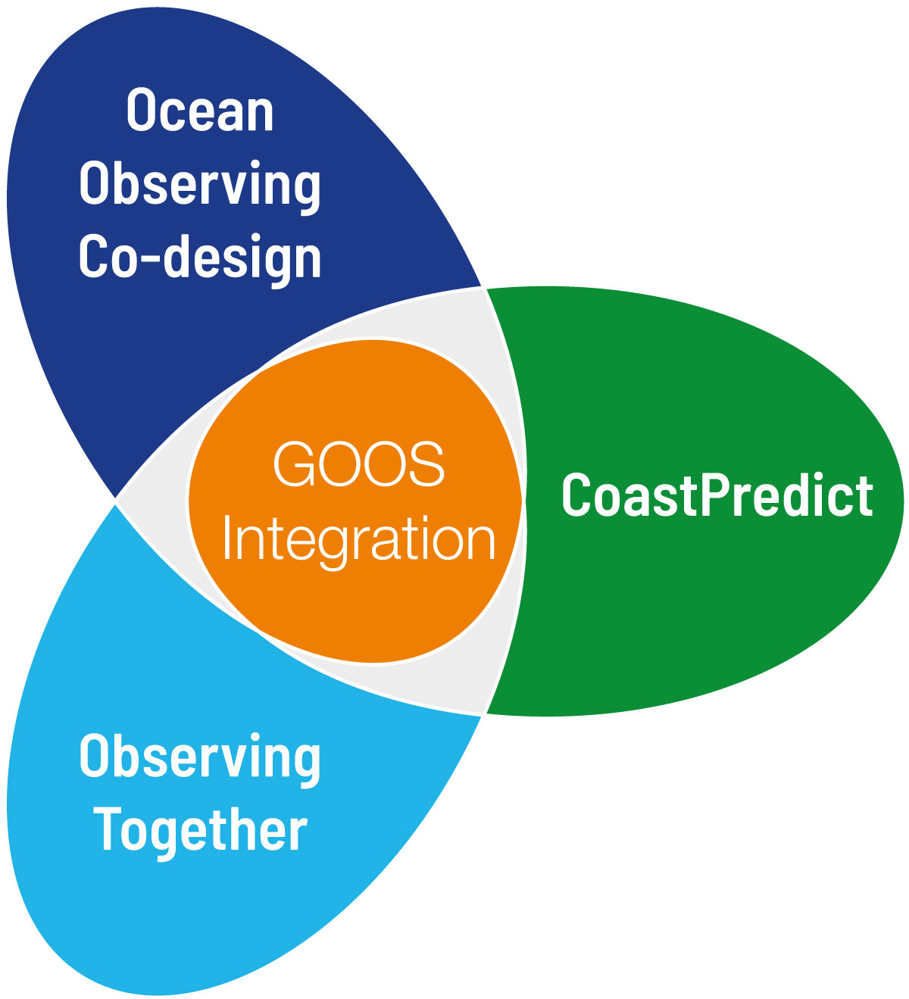
Working together: elevated level of collaboration for the Decade
MBON
SOCIB
Marine Life 2030
IODE
MOi
UNEP WCMC
IOOS
DITTO
Digital twin oceans
GCOS
COCAS
OASIS
Odyssey
Integrated ocean observing NW Atlantic
Bio-Eco Panel
OBON
OneArgo
AniBOS
GoShip Evolve
Ocean Practices (OBPS)
SMART cables
Recent behavior of cyclones and marine heatwaves [Bangladesh]
300 MERMAIDS
ForeSea / OceanPredict
Mercator
ICOS
WMO
IOCCP
Ocean monitoring & prediction: Gulf of Mexico / Caribbean
WCRP
Argo
IMOS
Coastal resilience programmes
ECMWF
IOC Marine Policy
OceanPredict
Copernicus Climate Change Service
Notes:
Here in red we’ve added the partners who were noted in the programme proposal

Slide 9
Thank you!
© SOCIB

Slide 10
The vision
Enhance access to ocean data in a way that is truly useful to enable informed decision making.
Connect observers and the communities they serve across the value chain.
Connect initiatives to contribute to an enhanced global system and strengthen a wide range of products.

Slide 11
In focus: Moroccan observing system
developing a national observations network
strengthen capacity in platforms and modelling
benefit from and adhere to best practices
In focus: Sailing 4 Science
enable and empower citizen science
frugal innovation, and cost-effective observation tools that exploit recent transformative technologies
focus on remote, understudied coastal ocean often coinciding with SIDS

Slide 12
Observing Together - meeting stakeholder needs and making every observation count
Notes:
We will leverage the Global Ocean Observing System’s (GOOS) network of expertise to bring needed observations and forecasts to community users and into global data streams. Observing Together will transform ocean data access and availability by connecting ocean observers and the communities they serve through enhanced support to both new and existing community-scale projects. It will include learning and sharing mechanisms that enable successful local initiatives to be replicated worldwide.

Slide 13
CoastPredict -
Notes:
We will leverage the Global Ocean Observing System’s (GOOS) network of expertise to bring needed observations and forecasts to community users and into global data streams. Observing Together will transform ocean data access and availability by connecting ocean observers and the communities they serve through enhanced support to both new and existing community-scale projects. It will include learning and sharing mechanisms that enable successful local initiatives to be replicated worldwide.

Slide 14
Stakeholder mapping: Tropical cyclones example
Expanded Observing Capacity
WMO/IOC/GOOS
Private Sector
Technology Developers
Data Suppliers
Ocean Observing Systems
Near Real-Time Data Flow
Delay-Mode Data Flow
Requirements & Feedback
Emergency Managers, Responders,
Media, Wx
Enterprise
Public, Offshore Operators, Resiliency Planners
Ensemble
Model Guidance
Tropical Cyclone Forecast Centers
Official Forecasts
& Warnings
Process Understanding
Operational Modeling Centers
Trusted Information
Research Scientists
Value Chain
Requirements & Feedback
Notes:
Scott

Slide 15
Ocean Observing Co-Design Programme objectives
1.
2.
Provide national government funders the information needed to target investment globally, regionally and locally.
Make ocean observing and information more accessible and impactful.
3.
4.
Develop system diagnostics, tools and reporting capability to better assess fitness-for-purpose across evolving requirements and use-inspired needs.
Establish international capacity and infrastructure to co-design and regularly evaluate the observing system at different scales by a centre of excellence.
Notes:
Engagement across obs-modeling communities and even some downstream stakeholders
Emerging potential set of “best practices” for co-design process.
Develop strong benefit statement (supported through economic impact analysis where possible)
Mapping: stakeholders and characterise interactions / users / regions / OSSEs

Slide 16
The objectives
1.
2.
3.
Equitable and practical access to ocean observations enabled by engagement and co-design with local stakeholders.
A system that makes a greater number of global and local observations available, integrated, interoperable and comparable.
Strengthened connections, mutual understanding, and improved knowledge sharing between ocean observers and the stakeholder communities.
4.
5.
Increased evidence that ocean observations are applied to solve problems and inform decision-making for any community – national, regional, or global.
Efficient design and use of ocean observations to maximise return on investment.

Slide 17
GOOS is the global home of ocean observing expertise.
We lead and support a community of international, regional and national ocean observing programmes, governments, UN agencies, research organizations and individual scientists.

Slide 18
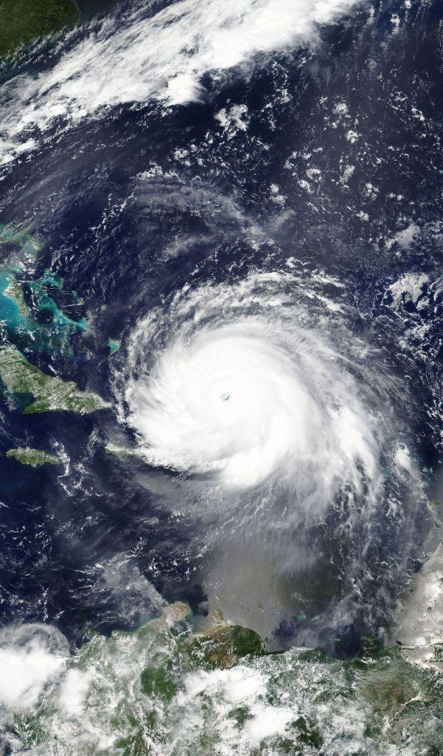
What next?
Prepare Exemplar project proposals for Workshop Day 4 Supporters Forum (Oct 2022) and for submission as a UN Decade Project
Paper to present initial summary of co-design best practices ‘Co-designing Science for the Ocean We Want’ - ICES Journal of Marine Science - abstract submitted
Opportunities at UN Ocean Conference in Lisbon to highlight the Exemplars, benefits and policy connections
Ideas/priorities for additional exemplars, particularly those that move towards an integrated ocean observing system

