Slide 1

SHAREMED
Task 4.4.1
North-west Mediterranean Pilot site
Web portal
Malta 2002 - SHAREMED International Workshop
Vincent FAURE, Christian Grenz
Programme co-financed by the
European Regional Development Fund
Programme cofinancé par le Fonds
européen de développement régional

Slide 2

SHAREMED: North-west Mediterranean Pilot site
Web portal (WP 4.4.1)
NW-med pilot site : https://sharemed.mio.osupytheas.fr/
WebGIS : https://sharemed-websig.mio.osupytheas.fr/
Objectives of this web portal
To develop a webGIS in order to visualize marine operational data on a public and shared portal (with simple and intuitive interface)
To show results from SHAREMED modelling activities on NWMED
To show maps from the SHAREMED Atlas activities

Slide 3
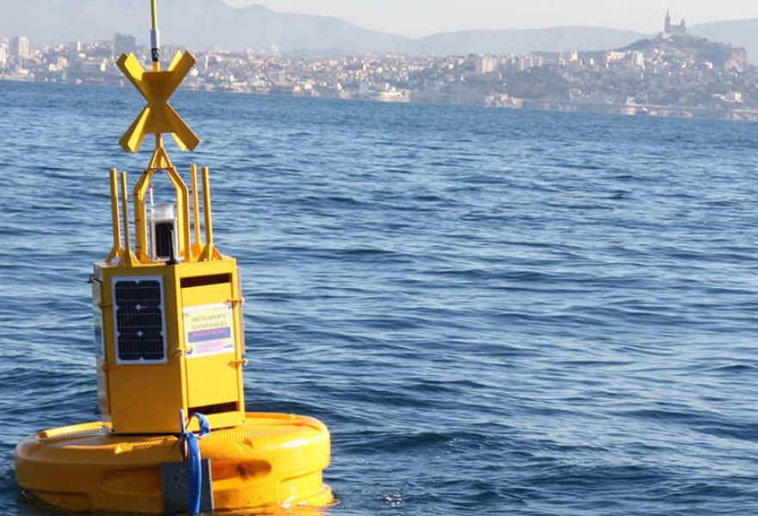
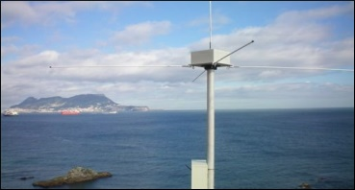
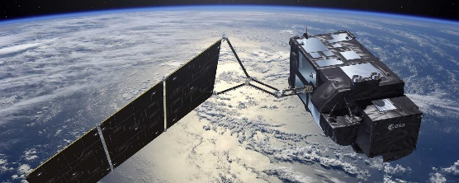

SHAREMED: North-west Mediterranean Pilot site
Web portal (WP 4.4.1)
Which operational marine data
are used ?
DATA from
T-30d to T+10d
Near-real time data from in situ marine buoys
Currents from coastal radar-HF
Near-real time satellite products
Simulations outputs from forecast models
CMEMS Insitu TAC
MIO
CMEMS Insitu TAC
MIO
CMEMS
CMEMS
SHAREMED WP5.1

Slide 4
SHAREMED: North-west Mediterranean Pilot site
Web portal (WP 4.4.1)
Ultra High resolution operational indicators of
Marine Heat Wave
(link with WP.4.3)
CMEMS MED SST ANALYSES
CURRENT STATUS
SST, SSTA, MHW-Category
SUMMARY for the last 15 days
  MHW Category (max.)
  Number of MHW-days
  Maximum intensity (°C)
  Cumulative intensity (°C.days)
SUMMARY since 1st January
  Total MHW-days
  Total Cumulative intensity (°C.days)
NRT-daily data
SST-L4NRT
Last 15 days
1km resolution
MHW climatology
SST-L4REP
1982-2011
5→1km resolution
Operational chain
MHW detection based on marineHeatwave.py
Running daily
MHW indicators
Current status + last 15 days and yearly summary
Following Hobday et al., 2016, 2018
https://sharemed.mio.osupytheas.fr/heat-stress-marine-heat-wave/
Notes:
In order to add some environmental indicators, we have developen in parallel a
Pressure on ecosystem is better if not detrended
Importance of threshold effect co
uld explain the difference with other direct.

Slide 5
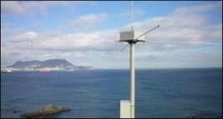


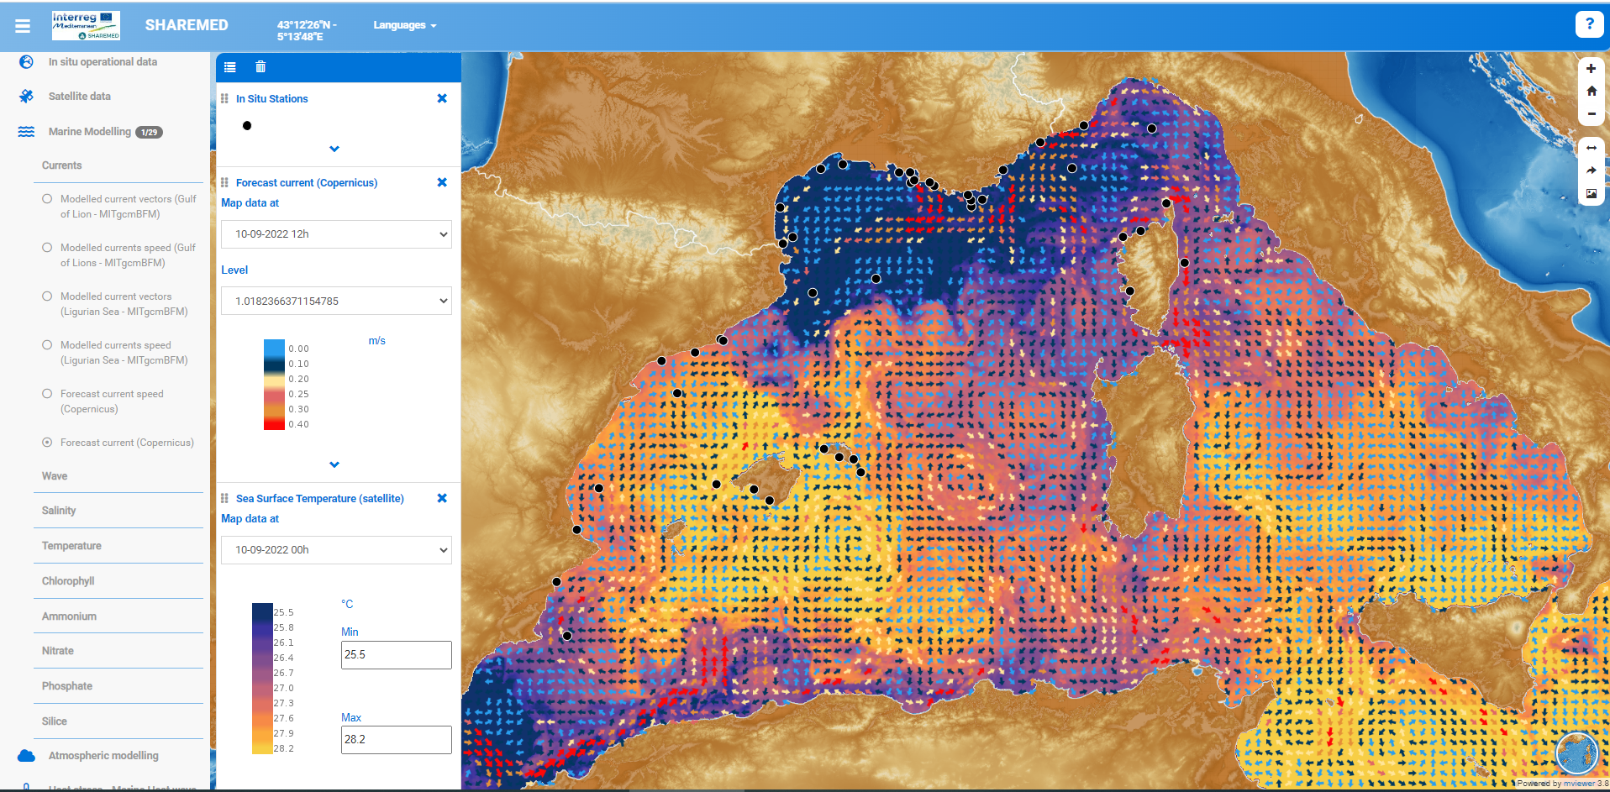
SHAREMED: North-west Mediterranean Pilot site
Web portal (WP 4.4.1)
Data providers
Global workflow of our webGIS
WORK SERVER
Download/manage data
Store ‘csv data’ (stations)
INTERNET SERVER
Web Server with webGIS code (Mviewer ©)
Download
HTTP
GEOSERVER©
Store netcdf data
View and edit geospatial data
Visualization for the FINAL USER
web browser
WMS
All codes and software are in open source and free
Desktop, tablet, smartphone
Notes:
GeoServer is a Java-based server that allows users to view and edit geospatial data

Slide 6
SHAREMED: North-west Mediterranean Pilot site
Web portal (WP 4.4.1)
Demonstration of the
whole front-end webGIS
https://sharemed-websig.mio.osupytheas.fr/
(public and free)
WebGIS dedicated to
heat stress and Marine Heat Wave
https://sharemed-websig.mio.osupytheas.fr/?config=apps/sharemed_heat.xml#

Slide 7
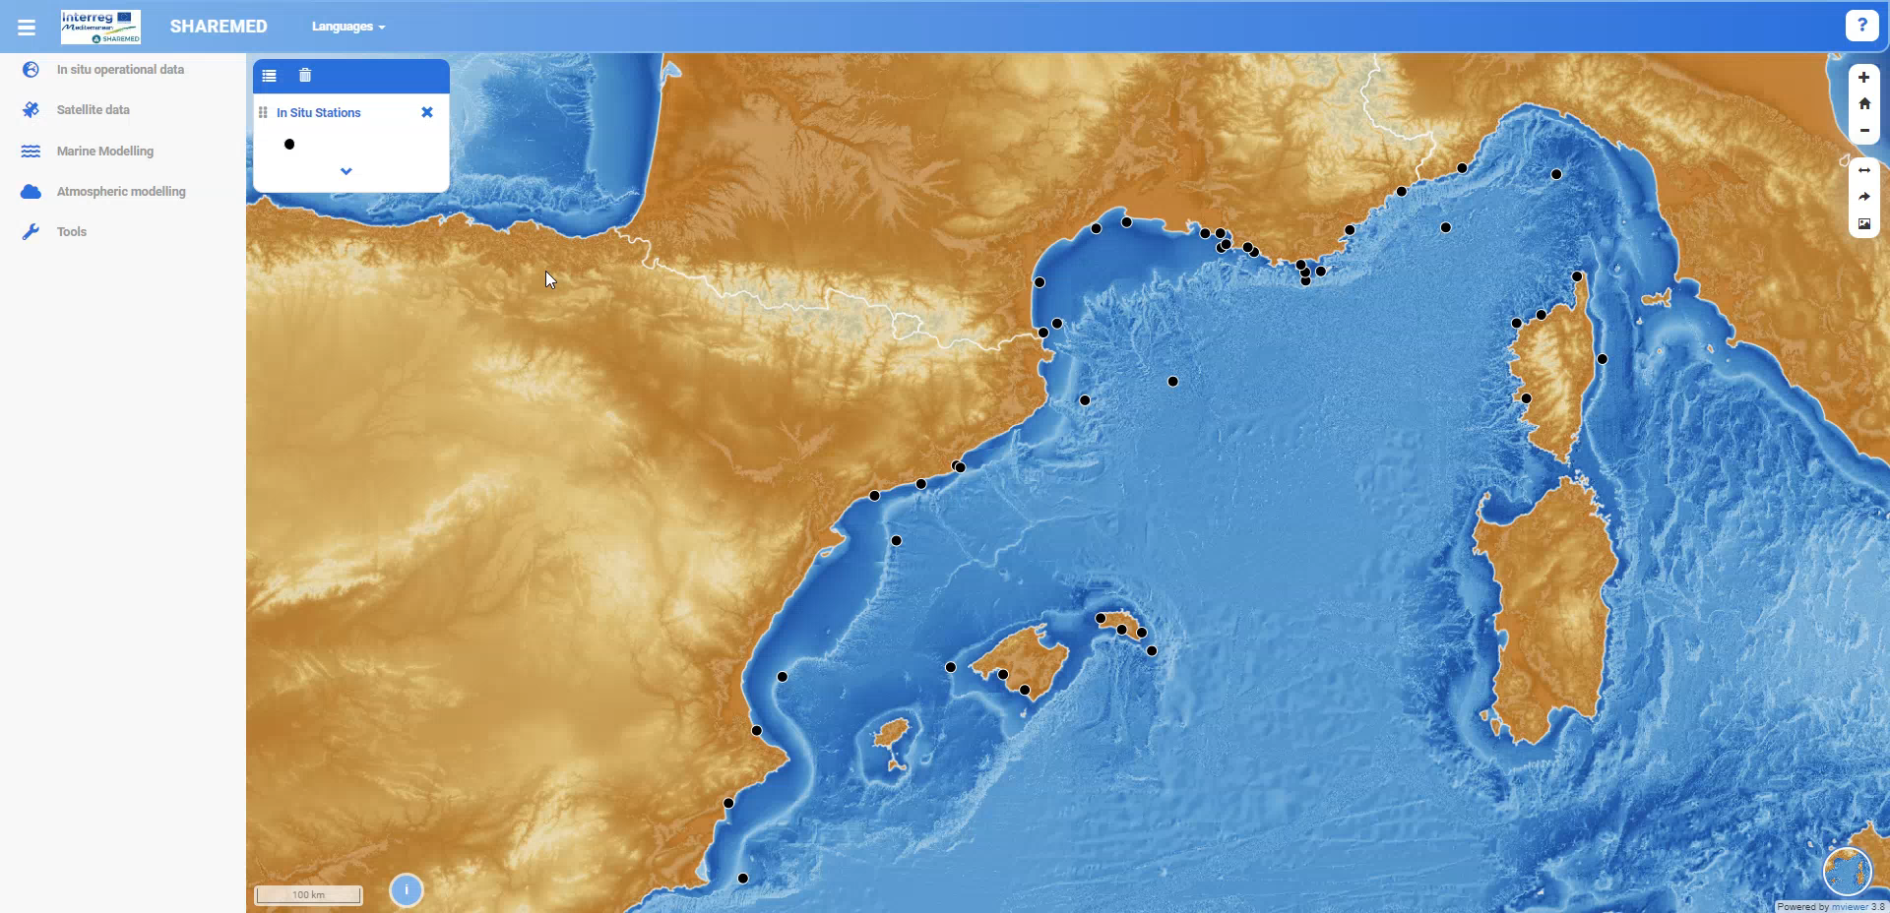
SHAREMED: North-west Mediterranean Pilot site
Web portal (WP 4.4.1)
Animation module
with pre-load system of images

Slide 8
Thank you
Hvala
Gràcies
Grazie
Nirringrazzjak
Obrigado
Xвала
D’akujem
Grazzi
.................
For more information :
vincent.faure@mio.osupytheas.fr
christian.grenz@mio.osupytheas.fr

Slide 9
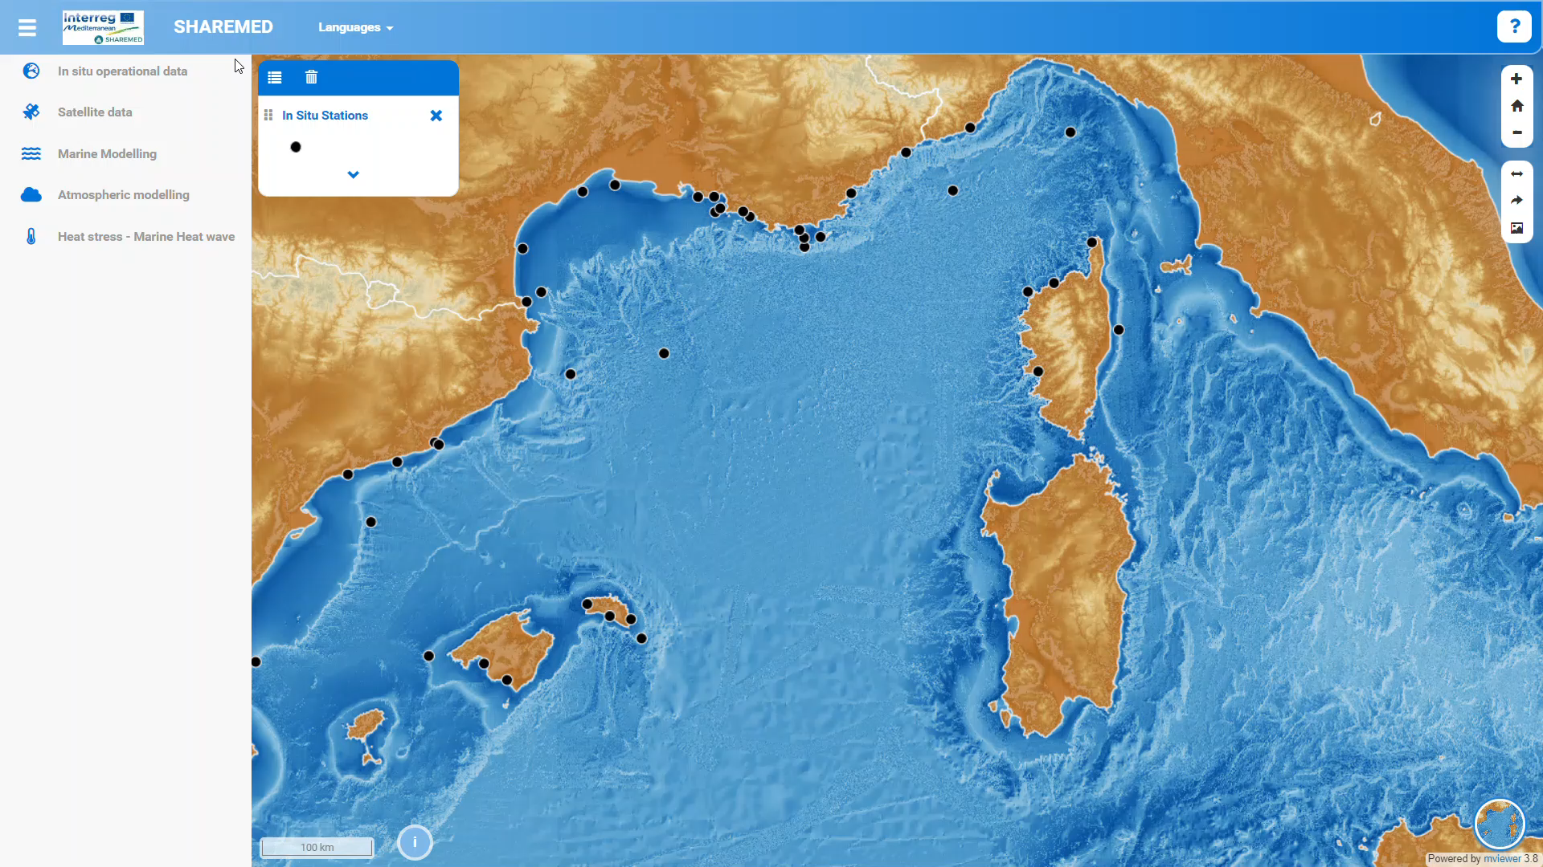

Slide 10


Slide 11
SHAREMED: North-west Mediterranean Pilot site
Web portal (WP 4.4.1)
Which in situ variables?
SEA WATER
WAVES
ATMOSPHERE
Sea Temperature
Salinity
Sea Pressure
Water sea level
Electrical conductivity
Current speed
Current direction
Wave Hs (H1/3)
Wave direction
Wave period T1/3
Wave Hmax
Sea level pressure
Air temperature
Gust wind speed
Longwave incoming radiation
Hourly Precipitation Rate
Incoming radiation
Humidity
Wind direction
Wind speed
REMOTE DATA
Satellite SST
Satellite ocean colour (Chla..)
Currents radar HF

Slide 12
SHAREMED: North-west Mediterranean Pilot site
Web portal (WP 4.4.1)
Which forecast variables ?
SEA WATER
WAVES
ATMOSPHERE
Currents
Chlorophyll-a
Nutrients
More ?
Wave Hs (H1/3)
Wave direction
Wave period T1/3
Wave Hmax
Not for the moment
CMEMS for the moment
Operational models from SHAREMED
Operational models from IFREMER in the future

Slide 13
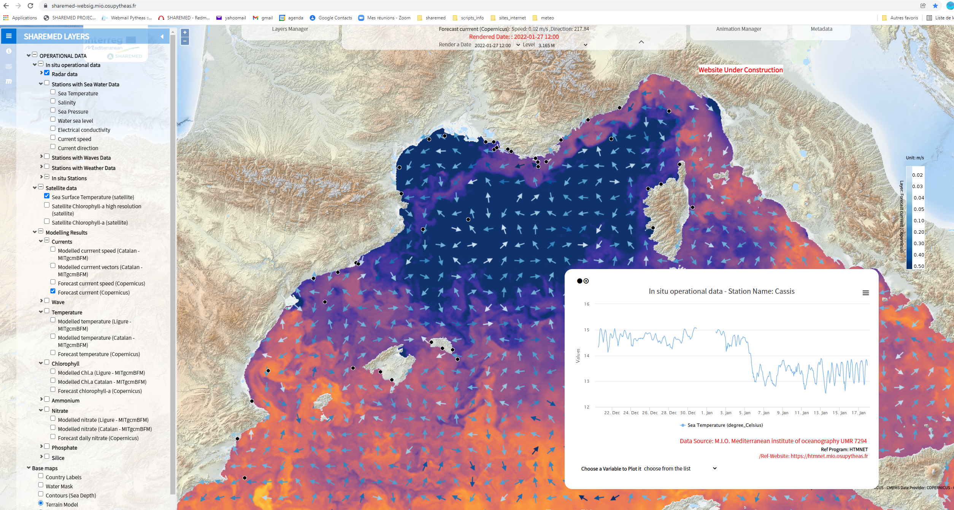
SHAREMED: North-west Mediterranean Pilot site
Web portal (WP 4.4.1)

