Slide 1
Science for Good environmental Status
S4GES
Dr. Patrick Roose, RBINS, Belgium

Slide 2
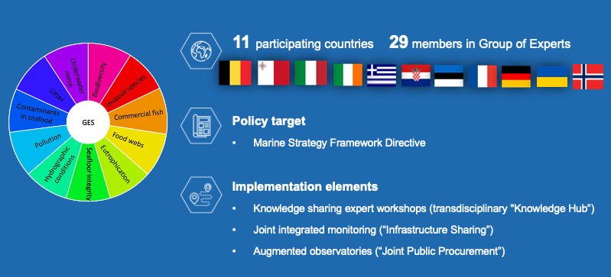
S4GES Joint Action
29 members in Group of Experts

Slide 3
Musing on the concept of Good Environmental Status: the complexity of the status & the status of complexity
Why now?

Slide 4
S4GES IS A TIMELY ACTION FOLLOWING THE RECENT COMMISSION STAFF WORKING DOCUMENT
‘Background document for the Marine Strategy Framework Directive on the determination of good environmental status and its links to assessments and the setting of environmental targets’
Brussels, 25.6.2020 SWD(2020) 62 final

Slide 5
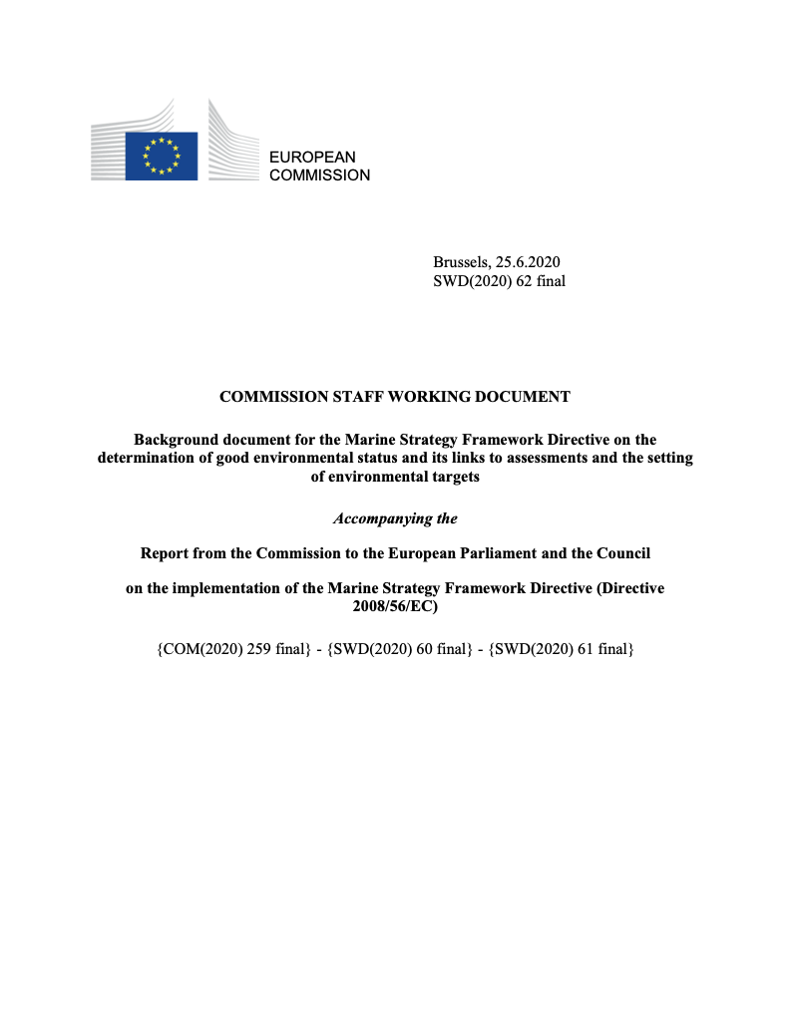
…The Commission’s assessment of the first implementation stage (Article 12 report, COM(2014)97) found a considerable divergence in approaches amongst Member States, particularly regarding the determination of GES, the use of Decision 2010/477/EU and the relationship between the determination of GES under Article 9 and the setting of environmental targets under Article 10. ..
…Good Environmental Status (GES) is the core concept to be achieved by Member States in implementing the MSFD. All operational provisions of the Directive are in one way or another linked to GES. Successful implementation depends on having sufficient clarity in the determination of GES to enable adequate decision-making in implementation of the Directive…

Slide 6
The determination of GES is progressively refined from its overall definition in MSFD Article 3(5), through the descriptors of MSFD Annex I, elements in MSFD Annex III and criteria of the GES Decision to the region- and subregion- specific determinations of Article 9(1).
The definition of environmental status in Article 3(4) provides a high-level perspective on what needs to be taken into account when assessing the ‘state’ of the environment:
‘the structure, function and processes of the constituent marine ecosystems together with natural physiographic, geographic, biological, geological and climatic factors, as well as physical, acoustic and chemical conditions, including those resulting from human activities inside or outside the area concerned’.
The definition of good environmental status (GES) in Article 3(5) further elaborates on this by defining the high-level goal of the Directive:
‘good environmental status' means the environmental status of marine waters where these provide ecologically diverse and dynamic oceans and seas which are clean, healthy and productive within their intrinsic conditions, and the use of the marine environment is at a level that is sustainable, thus safeguarding the potential uses and activities by current and future generations, i.e.:
the structure, functions and processes of the constituent marine ecosystems, together with the associated physiographic, geographic, geological and climatic factors, allow those ecosystems to function fully and to maintain their resilience to human-induced environmental change. Marine species and habitats are protected, human-induced decline in biodiversity is prevented and diverse biological components function in balance;
hydro-morphological, physical and chemical properties of the ecosystems, including those properties which result from human activities in the area concerned, support the ecosystems as described above. Anthropogenic inputs of substances and energy, including noise, into the marine environment do not cause pollution effects.’

Slide 7
Good environmental status?
GES is based on the values of ocean variables associated to different ecosystem components, which are specified in the criteria of 11 GES descriptors
These variables and related indicators should be relatively simple to measure and communicate
GES is evaluated by comparing the results for these variables against threshold values
but …

Slide 8
Good environmental status?
Point sampling at dedicated stations
structure, function and processes
natural physiographic, geographic, biological, geological and climatic factors
Sample analysis
?
inside or outside the area concerned’.
Data interpretation
Comparison against indicator
physical, acoustic and chemical conditions, including those resulting from human activities
Extrapolation
MSFD in current practice: does it reflect reality?

Slide 9
Good environmental status?
Resolving temporal and spatial variability, as well as environmental feedbacks, in the marine realm remains particularly difficult because of their naturally highly complex and non-linear dynamics.
Determination of statistically robust trends requires long-term time-series/ datasets with the current approaches
Indicators may also show differed and delayed response to anthropogenic pressures and changes in environmental hydrological, climatic, and ecological conditions.
As a consequence, appropriate indicators often seem to be far from having been identified and the scientific bases for the definition of the thresholds appear highly challenging.

Slide 10
complexity cannot be approached by addressing the status of the system as the sum of single parts

Slide 11
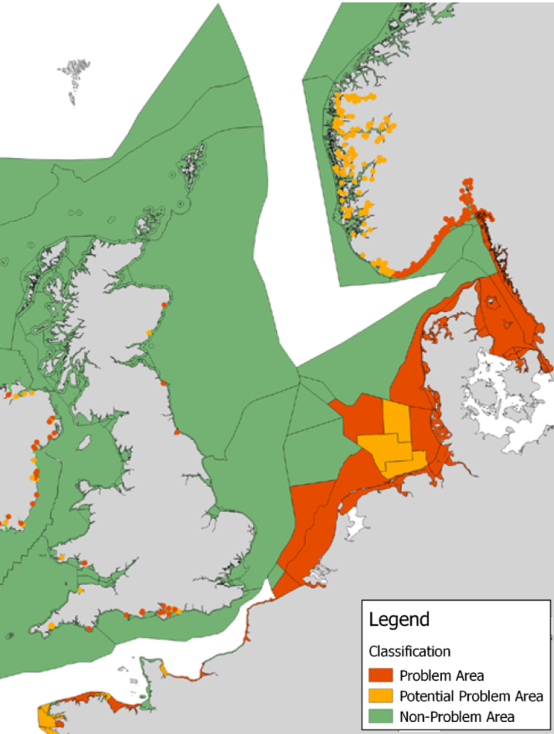
Chlorophyl a as a proxy for primary production
Good environmental status: an example

Slide 12
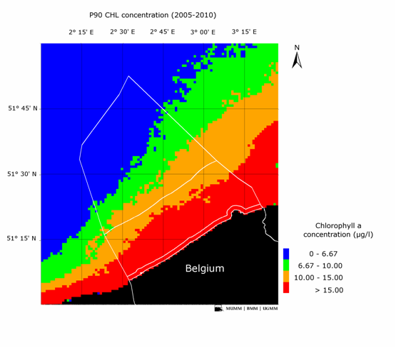

Good environmental status: an example
Satellite-based eutrophication assessment for the same OSPAR convention zone
CHLa 90 percentile (MERIS,2005)
Belgian CHLa 90% Mar-Oct 2005-2010, Water Framework Directive product
[Image: D. Vanderzande]

Slide 13

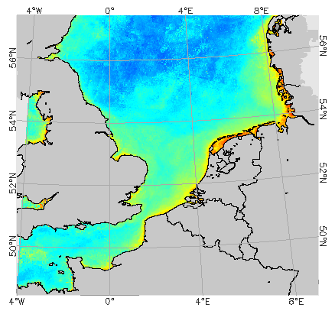
Good environmental status: what we need!
CHLa (MERIS,2003)

Slide 14
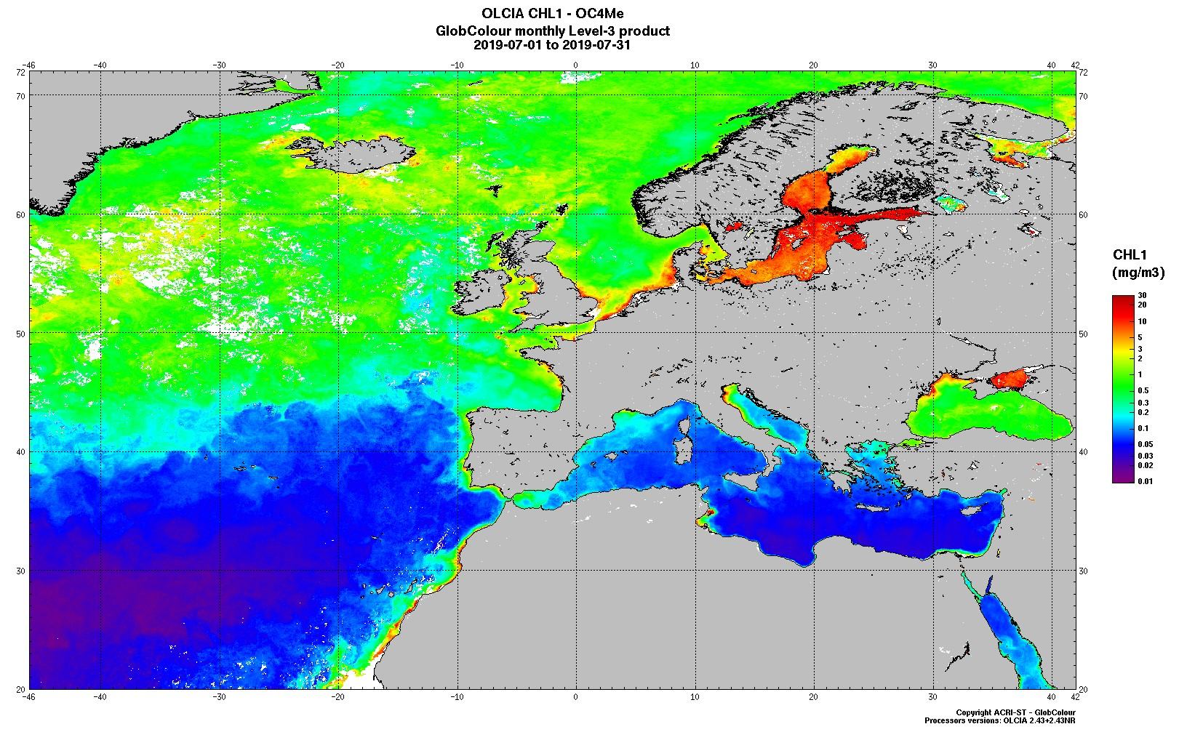
Good environmental status: what we need!
Bad
Good

Slide 15
Our vision
From in situ observations with research vessels, limited in space and time

Slide 16
Our vision
To in situ observations combined with continuous data from augmented observatories
Augmented observatories

Slide 17
Augmented observatories
Our vision
Integrated observing, monitoring, and experimenting infrastructures
High resolution data collection
Automated and autonomous
Multidisciplinary measurements
Real or near-real time link with the mainland
Co-localization and synopticity of observations

Slide 18
Our vision
Synchronous observations

Slide 19
Our vision

Slide 20
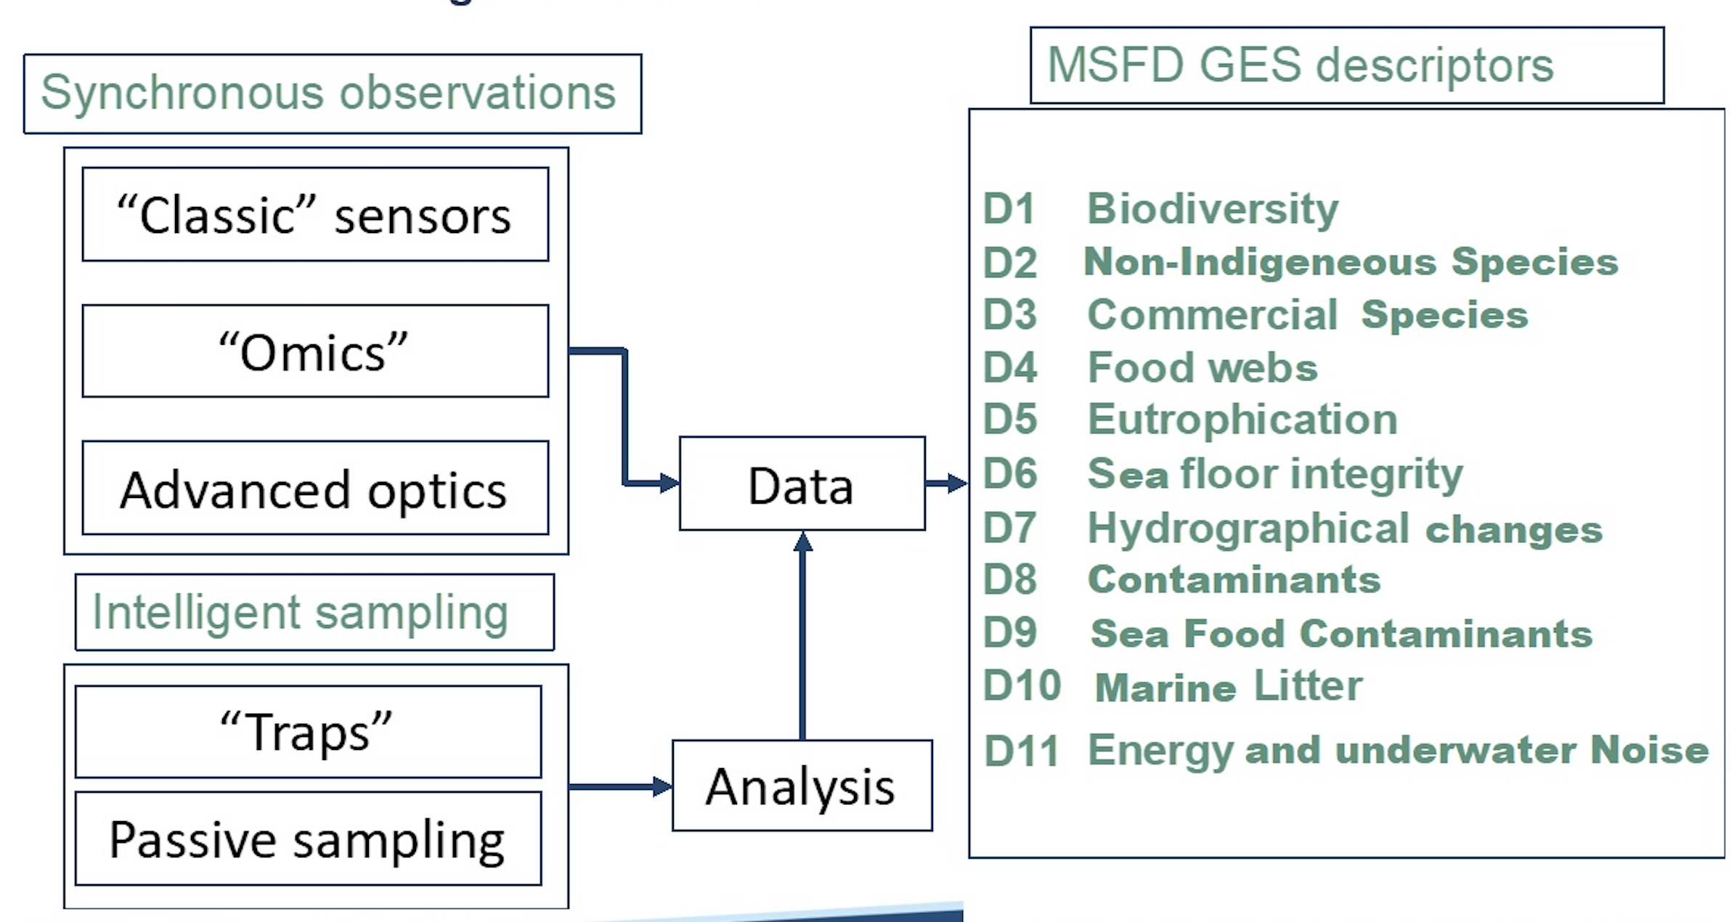
Our vision

Slide 21
Our vision
From large scale overarching patterns and observations
To in depth analysis of deviations and trends
Translating the complexity of the status
Into the status of the complexity or GES

Slide 22
Our vision
Translating the complexity of the status
Into the status of the complexity or GES
Joint Integrated monitoring approaches
Knowledge sharing
Test beds & augmented observatories

Slide 23
What has been done
Almost weekly meetings between JPIO-secretariat and pilots
Workshop (virtual) exploring and discussing novel approaches/concepts for environmental monitoring
3 working groups were established working on concept notes that developed the idea’s from the workshop
Workshop with experts preparing a joint research cruise aimed at testing the concepts
Development of the cruise by 3 dedicated groups of experts

Slide 24
What has been done
S4GES task teams finalized concept notes on Ecosystem Dynamics, Biodiversity and Fishery, and Contaminants within which they identified hypotheses that need to be tested for assessing the Good Environmental Status. These concept notes and their commonalities and differences were discussed at the October 2021 workshop.

Slide 25
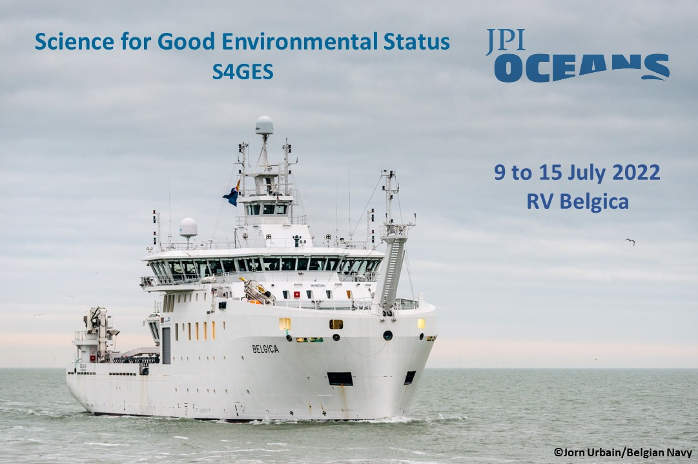
The 2022 cruise

Slide 26
The 2022 cruise
Cruise aims
Proof of concept approach
Focus on upper water layer i.e. plankton community
Southern bight of the North Sea
Near shore and off-shore sampling

Slide 27
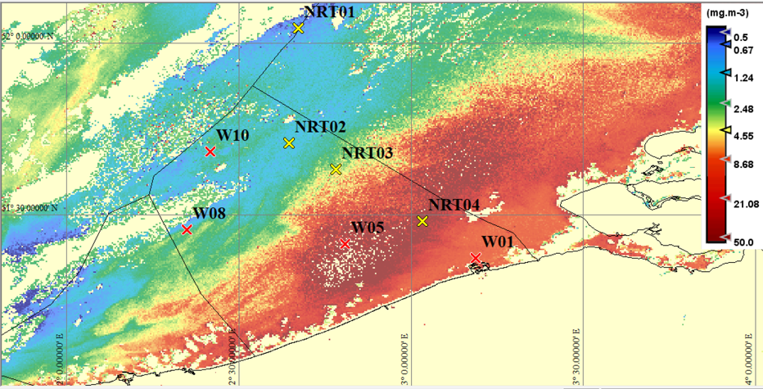
The 2022 cruise
Working group on physical oceanography: supporting sampling strategies by recognizing those physical and bio-geochemical patterns that highlight spatial and temporal ecosystem dynamics.
Near real time sampling based on observations!

Slide 28
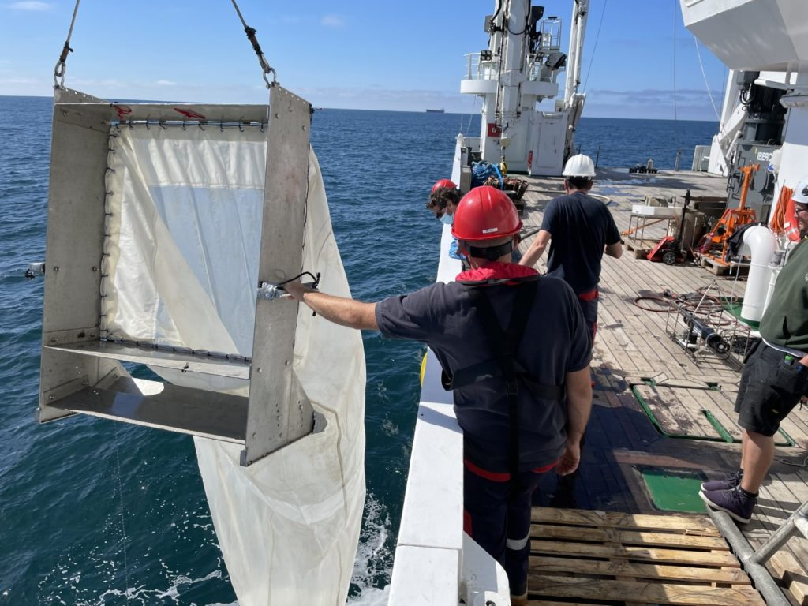
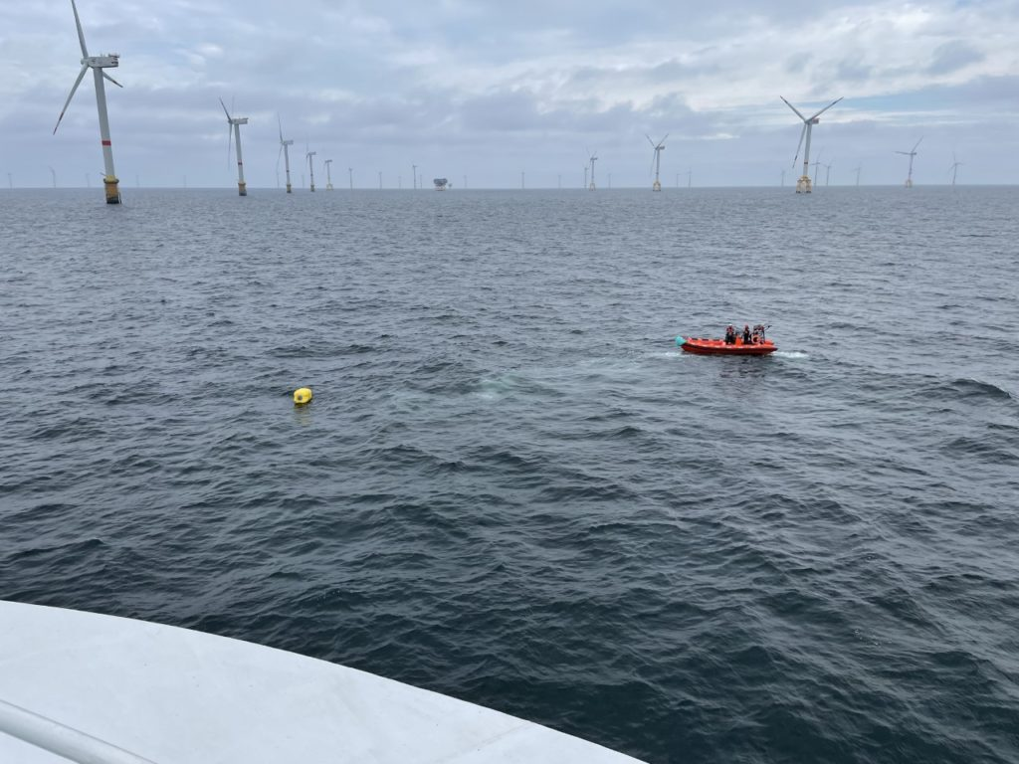
The 2022 cruise
Working group on biodiversity: developing eDNA techniques for documenting the diversity of all ecological groups simultaneously without disturbing the organisms and their environment

Slide 29
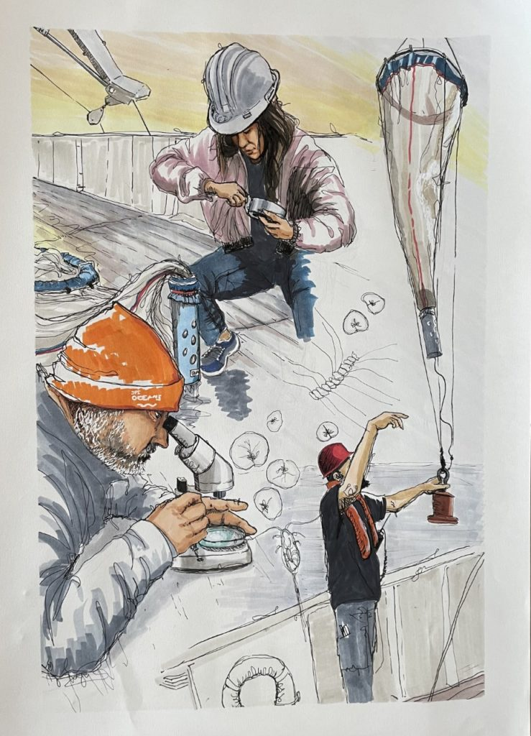
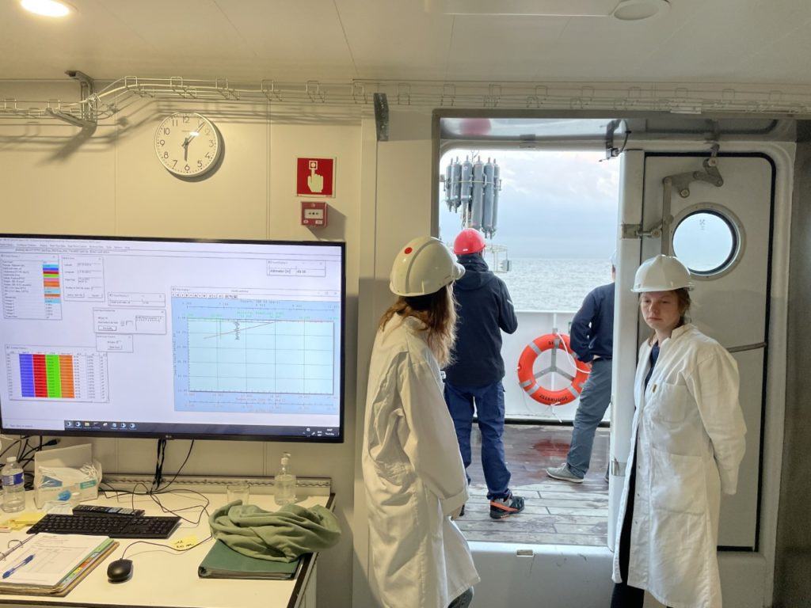
The 2022 cruise
Working group on the trophic web: to select and test indicators (for the assessment of Good Environmental Status) which explicitly consider trophic networks.

Slide 30

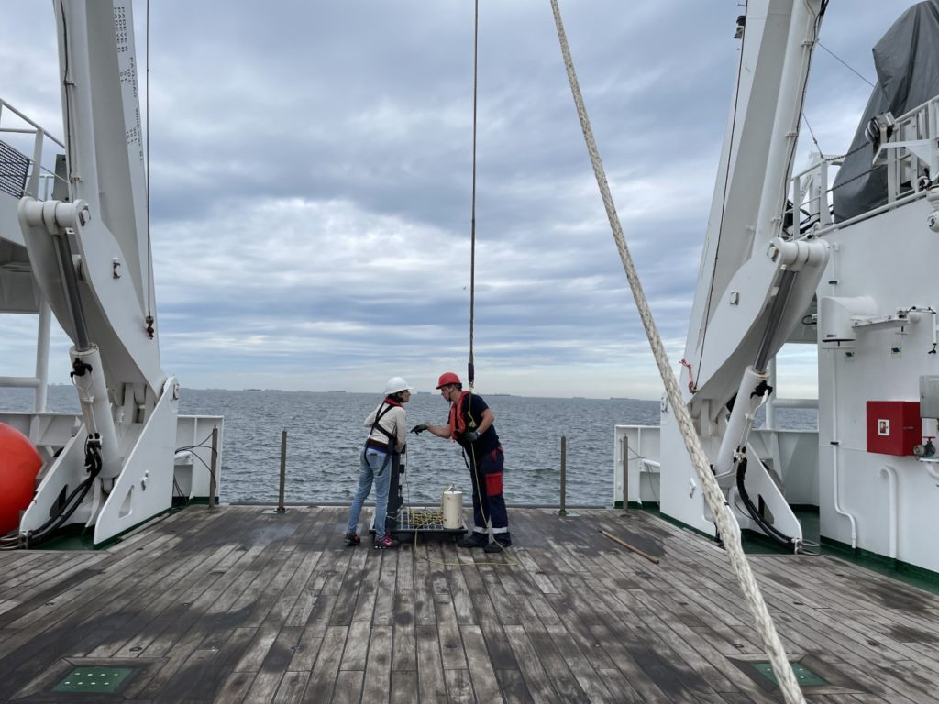
The 2022 cruise
Working group on contaminants: evaluate the accumulation and transfer of metallic contaminants within the plankton food webs

Slide 31
THANK YOU

