Slide 1
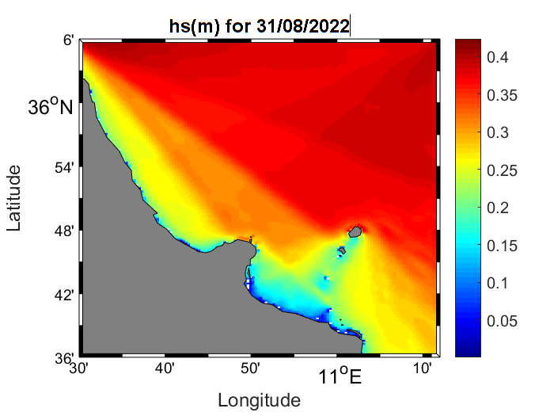
SHAREMED on demand action : SWAN, Wave model implementation
The action is under the responsibility of Joel Azzopardi Faculty of Information & Communication Technology (ICT), university of Malta.
Realised by Nadia Mkhinini, Sea-gust & University of Sciences Bizerta, Tunisia

Slide 2
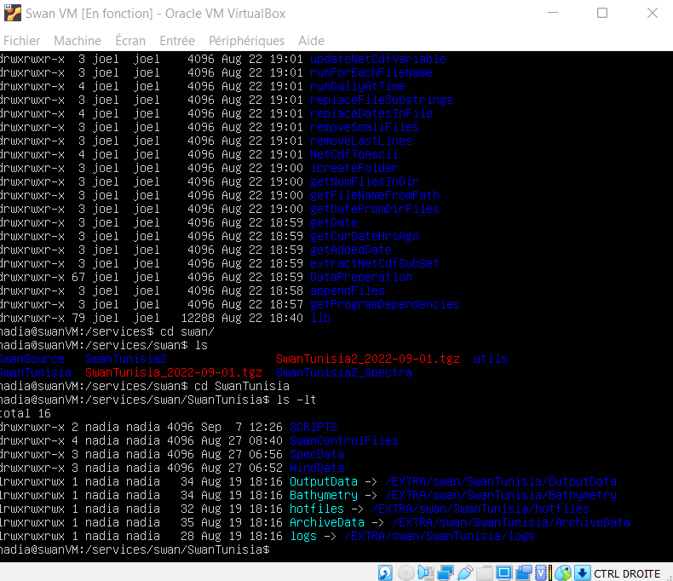
Aim of the action : Implement the SWAN model which is a high resolution wave forecasting model with nesting to the CMEMS Mediterranean scale forecasting system.
The Swan Version used is 41.41
The work is done via a virtual ToolBox connected to the local server.

Slide 3
Inputs
Boundary Conditions: Wave Spectra CMEMS
Spacial resolution: 0.04
Meteo Forcing: Skiron:
Spacial resolution :0.05
temporal resolution: hourly
Skiron have available 8 days forecast
Outputs
Hourly output
120 hours forecast horizon (from Day 1 00:00GMT to Day 5 00:00GMT)
Forecast Horizon
120 hours / 5 days starting at 00:00 on Day 0

Slide 4
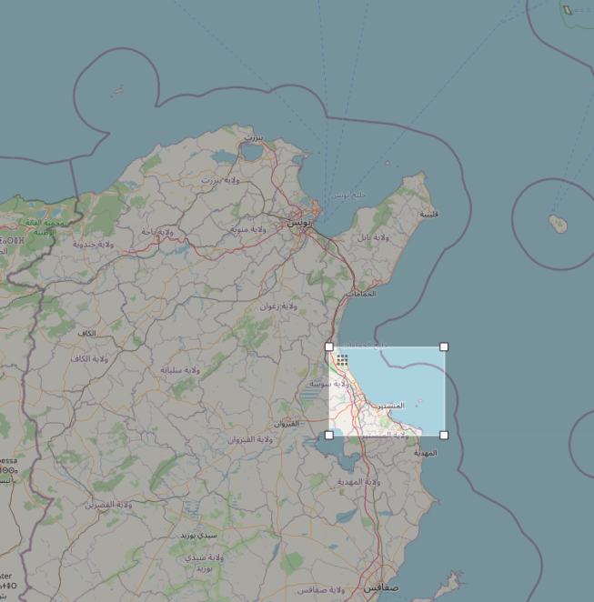
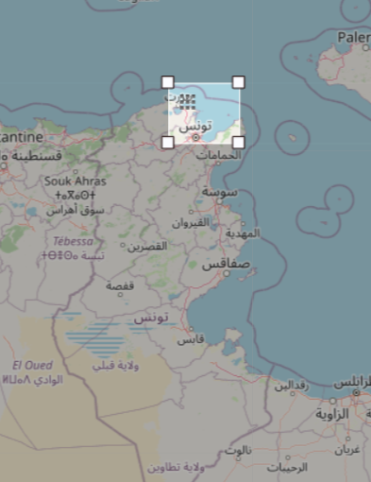
Simulation for 2 domains
Domain 1 : focus on Monastir
(east coast of Tunisia)
lat S : 35.6 | lat N : 36.1
long O: 10.4 | long E : 11.2
Domain 1 : focus on Bay of Tunis
lat S : 35.6 | lat N : 36.1
long O: 10.4 | long E : 11.2

Slide 5
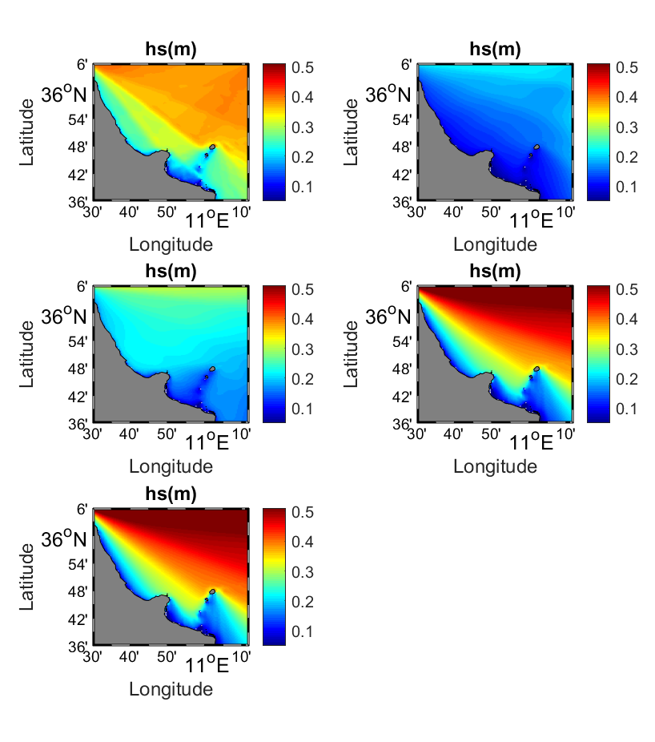
31/08/2022
01/09/2022
02/09/2022
03/09/2022
04/09/2022
hs for domain 1 : focus on Monastir
(east coast of Tunisia)

Slide 6
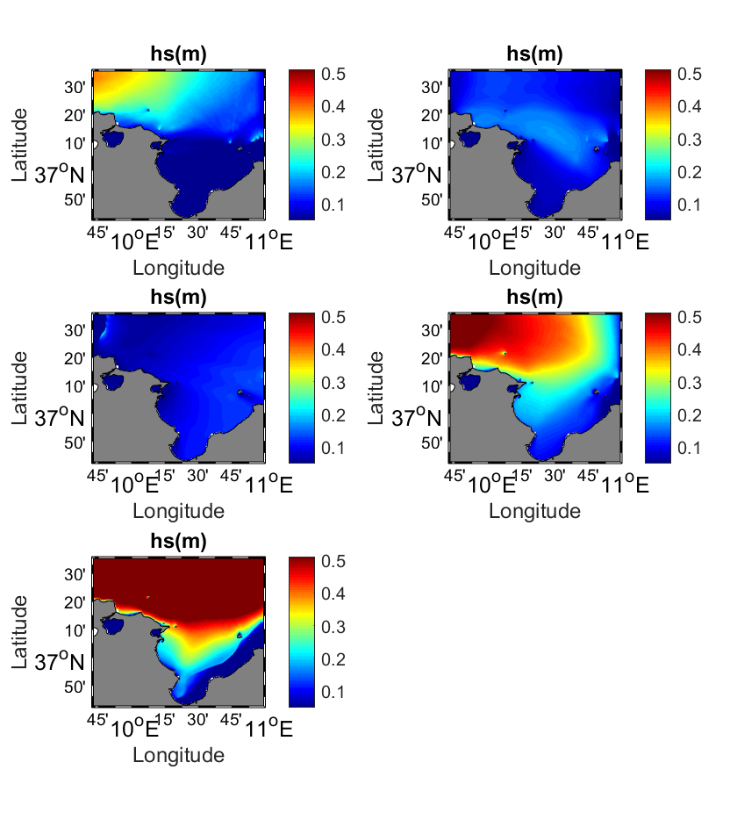
31/08/2022
01/09/2022
02/09/2022
03/09/2022
04/09/2022
hs for domain 2 : focus on Bay of Tunis

