Slide 1
INTRODUCTION COURSE TO MARINE MONITORING HARDWARE AND PROCEDURES
SHAREMED
Vanessa Cardin
SHAREMED International Workshop
Connecting marine research and boosting benefits to Society
Malta 13-14 September 2022

Slide 2
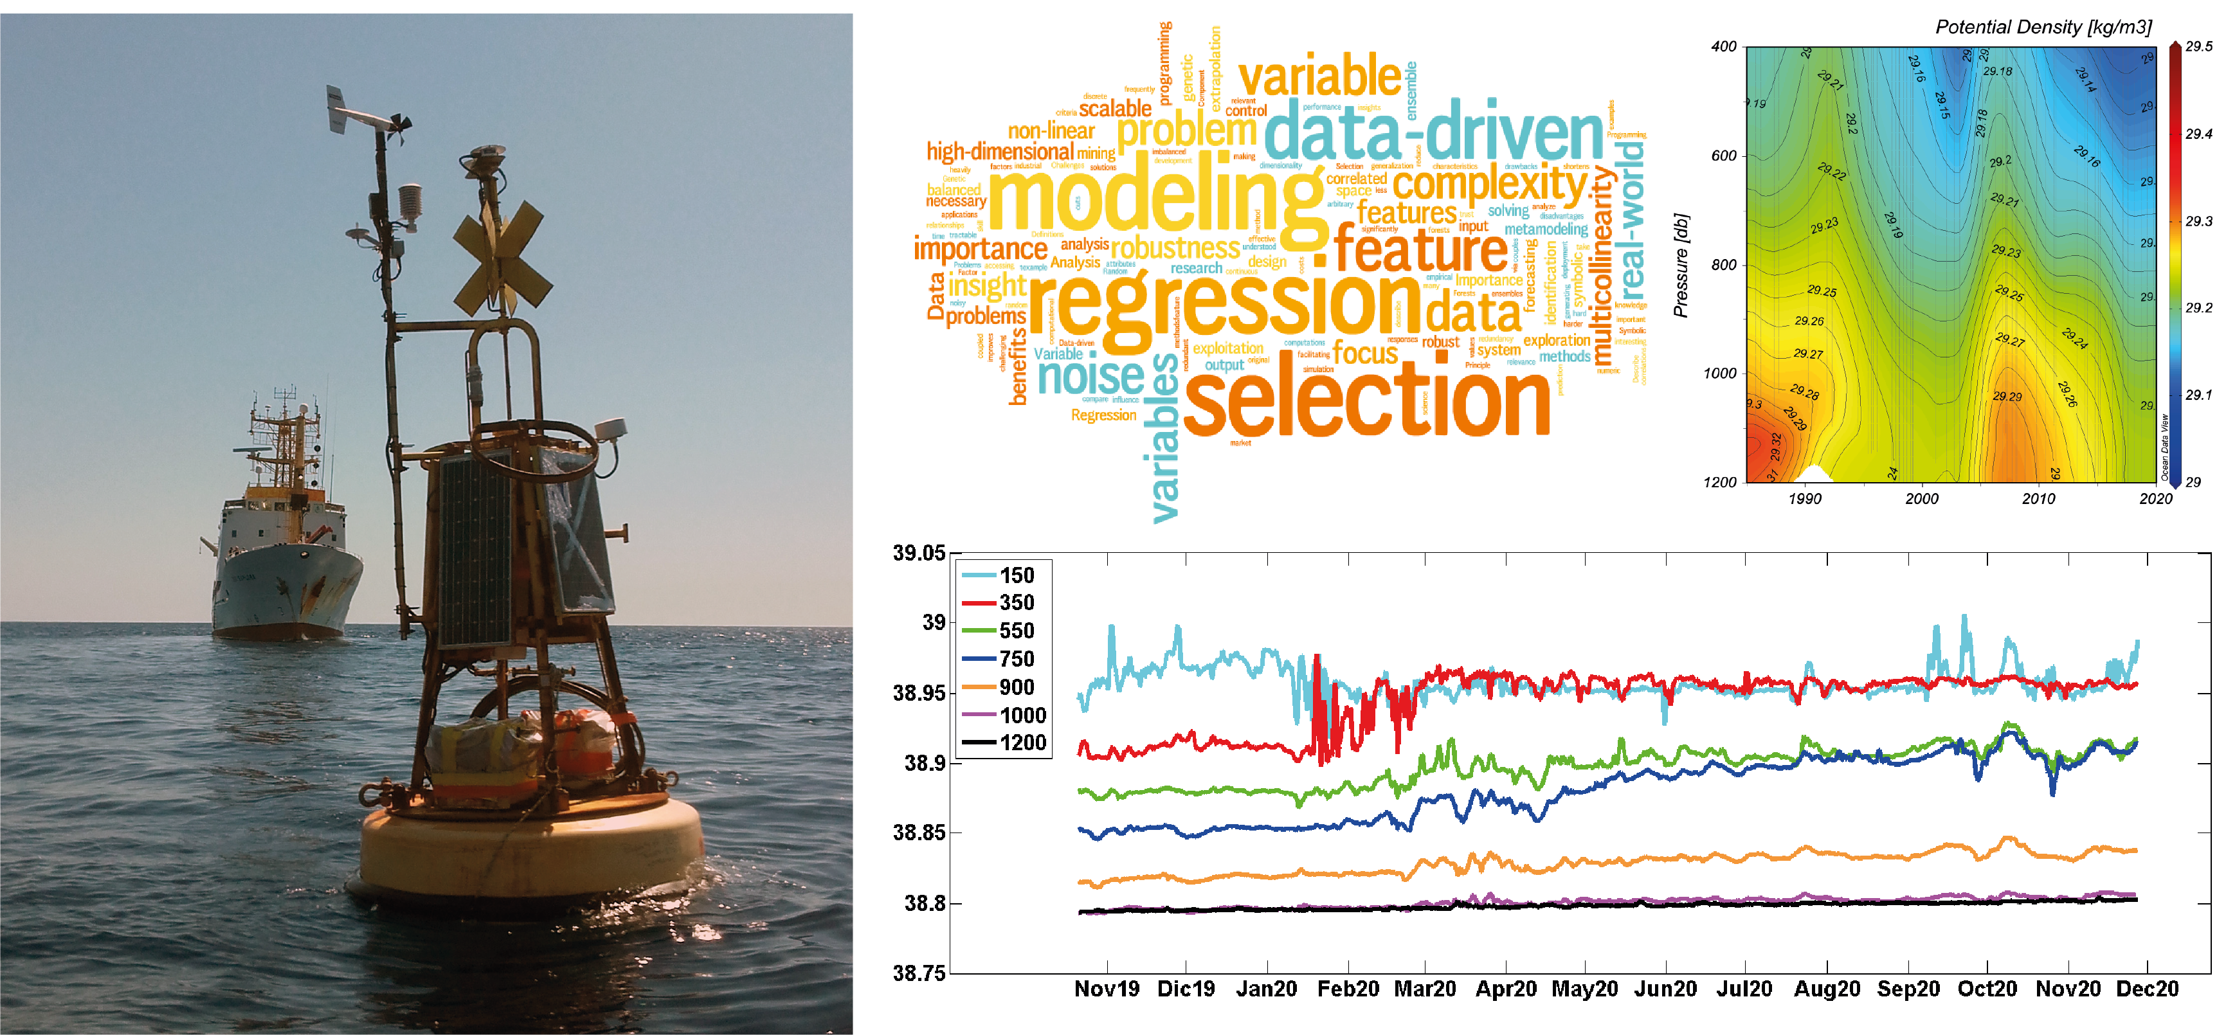
Practical introduction course to marine monitoring hardware and procedures for less experience users
Trieste 22-25 June 2022
GOAL: to introduce and teach practical procedures to a larger group of practitioners involved in meteorological and marine observations.
Aim of the Course:
Introduction to physical and biochemical instrumentation, setup, programming, downloading and conversion of data.
Training participants in all steps of instrument use, Emphasis is on biochemical measurements of carbonate species, ocean acidification sensors, fluorometers, and automated nitrate measurements.
TARGET: less experienced hardware users, PhD students and young scientist from different countries, also Sharemed and MonGOOS partners
SHAREMED International Workshop – Malta 13-14 September 2022
Notes:
Introduction to physical and biochemical instrumentation, setup, programming, downloading and conversion of data.
Training participants in all steps of instrument use, from the calibration process and setup to downloading and converting data.
Emphasis is on biochemical measurements of carbonate species, ocean acidification sensors, fluorometers, and automated nitrate measurements.

Slide 3
Practical introduction course to marine monitoring hardware and procedures for less experience users
Participants from:
Greece (1), Italy (1), Algeria (1), Egypt (2), Morocco (1), Nigeria (1), Tunisia (3)
The primary sessions covered:
Best practises approaching a mooring set-up
Methodologies of measurements of basic parameters
Overview of hardware and monitoring
Importance of accurate observational data
Calibration best practices
Data Quality Control
Very hetereogenic group
The expertise of the participant covered:
physical and biochemical oceanography,
robotics,
aquaculture and fisheries,
environmental management.
SHAREMED Workshop – Malta 13-14 September 2022

Slide 4
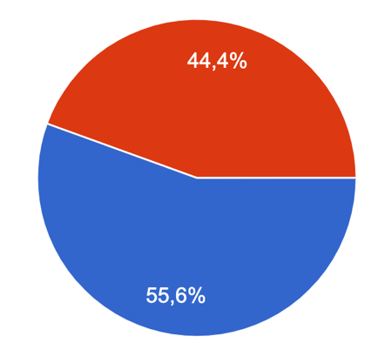
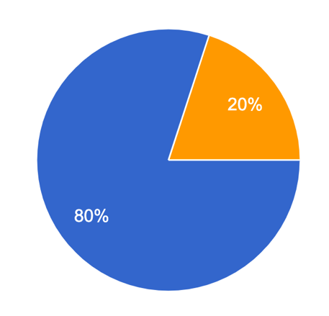
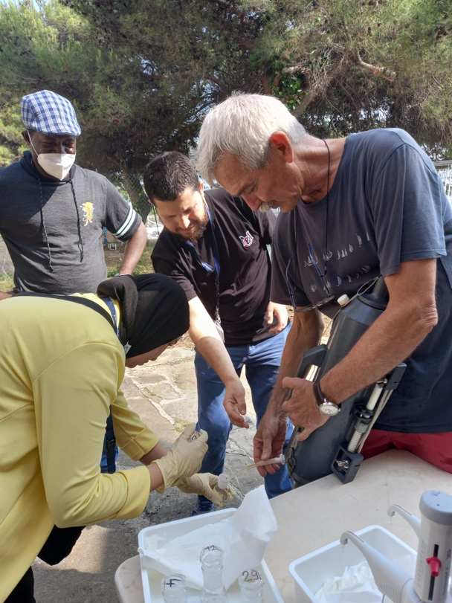
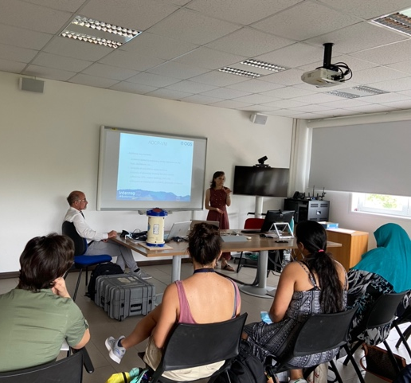
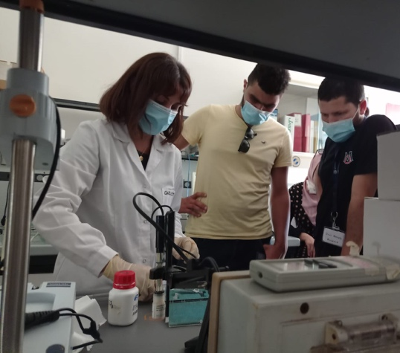
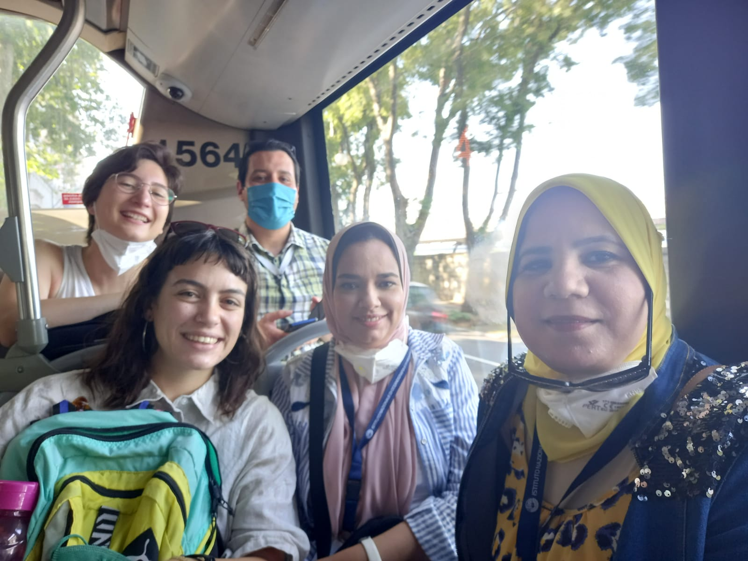
The participants….
Gender balance
Duration of the Course
Male
Too short
Female
Adequate
The acquired knowledge about marine infrastructures will be helpful for my future work?
SHAREMED Workshop – Malta 13-14 September 2022

Slide 5
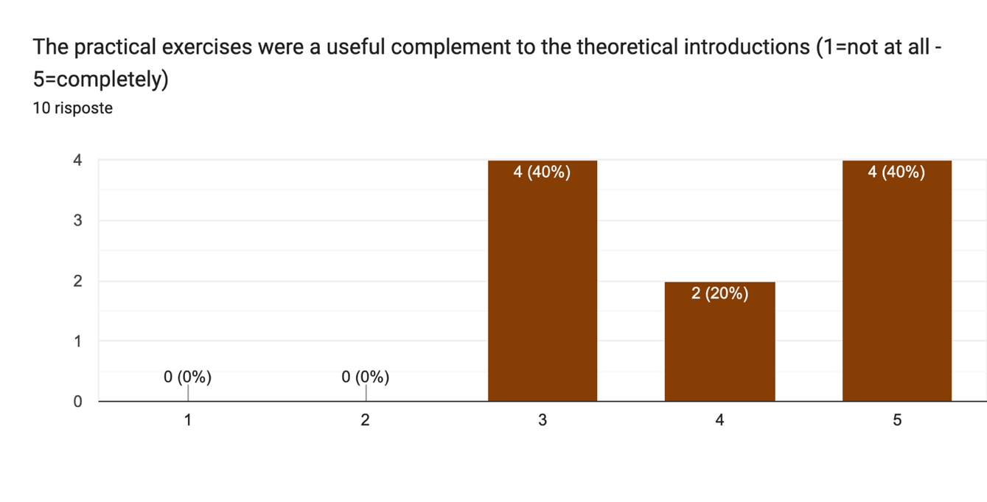
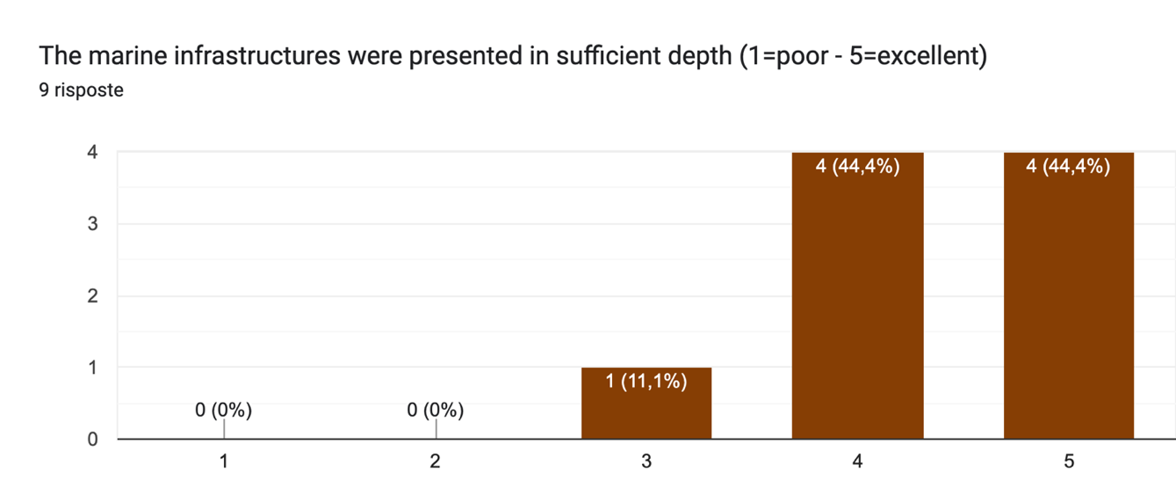
Some feedbacks from the participants….
SPECIAL THANKS TO OGS PERSONNEL THAT COLLABORATE AND PARTICIPATE AS PRESENTERS DURING THE COURSE
SHAREMED Workshop – Malta 13-14 September 2022

Slide 6
…more feedbacks….
What else do you think should have been covered in the course?
….field work (deployment of one or more type of instrument) and Increase time (hrs.) of practical exercise for programs…
How can the course be improved from your point of view?
……the course could be improved by extending the period to accommodate a short cruise for equipment deployment and data acquisition ….
…the targeted audience should be more coherent…
…one week is few for the course. Too much information short time..
SHAREMED Workshop – Malta 13-14 September 2022

Slide 7
but….
Would you recommend to other persons to attend a similar activity in the future?
SHAREMED Workshop – Malta 13-14 September 2022

Slide 8
THANK YOU! Grazie
Vanessa Cardin
OGS
vcardin@ogs.it
SHAREMED Workshop – Malta 13-14 September 2022

