Slide 1

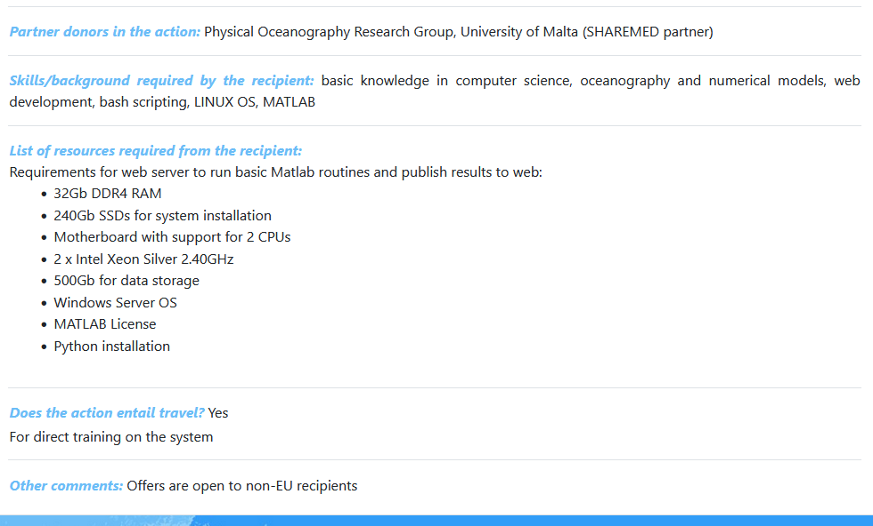
Title of Action:
Web interface for CMEMS operational forecast visualisation
Donor Institute: University of Malta

Slide 2
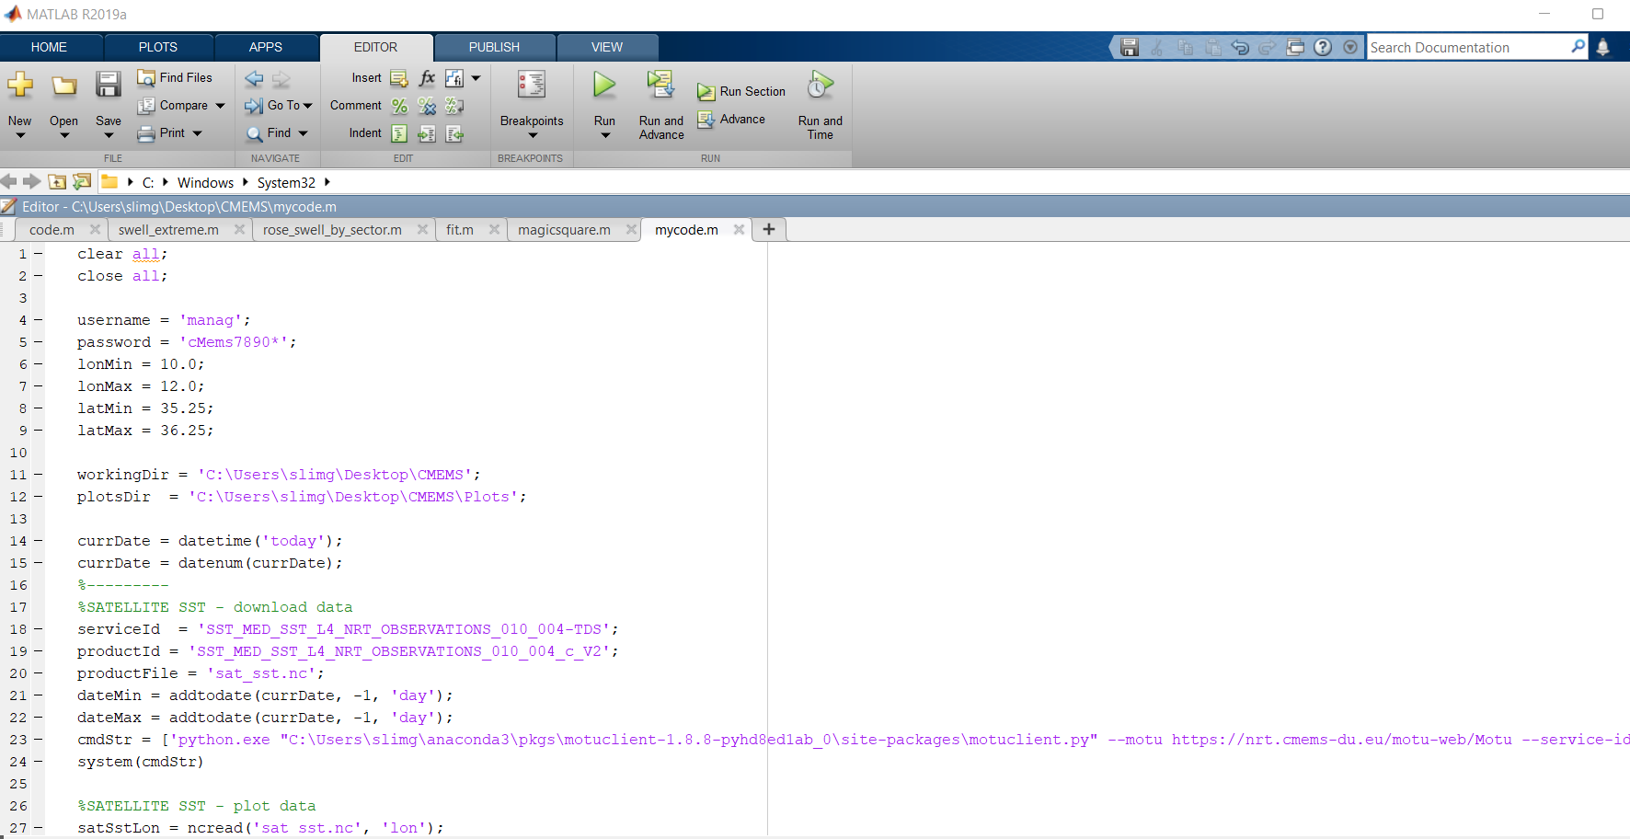
SPECIFY THE PARAMETERS OF THE CMEMS FILES, AREA OF INTEREST AND DATES INSIDE A MATLAB SCRIPT

Slide 3
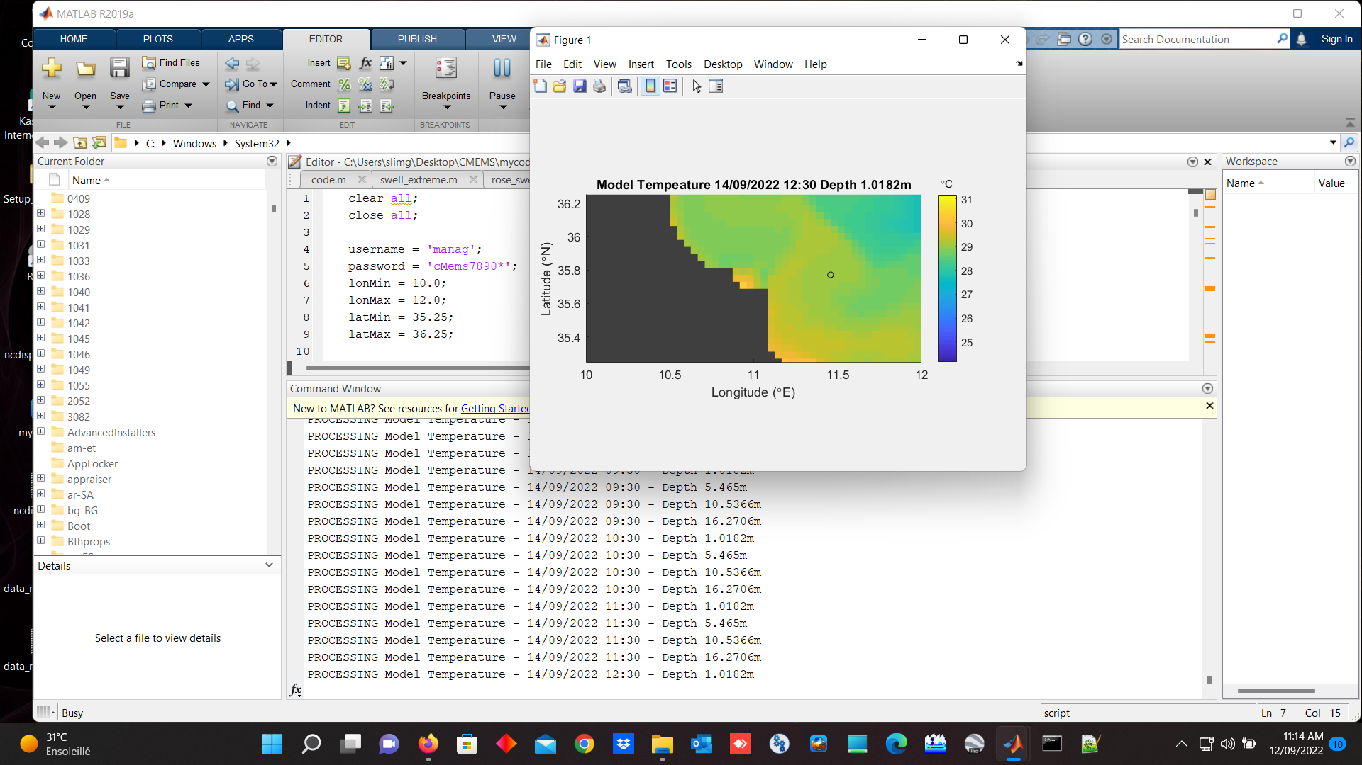

Slide 4
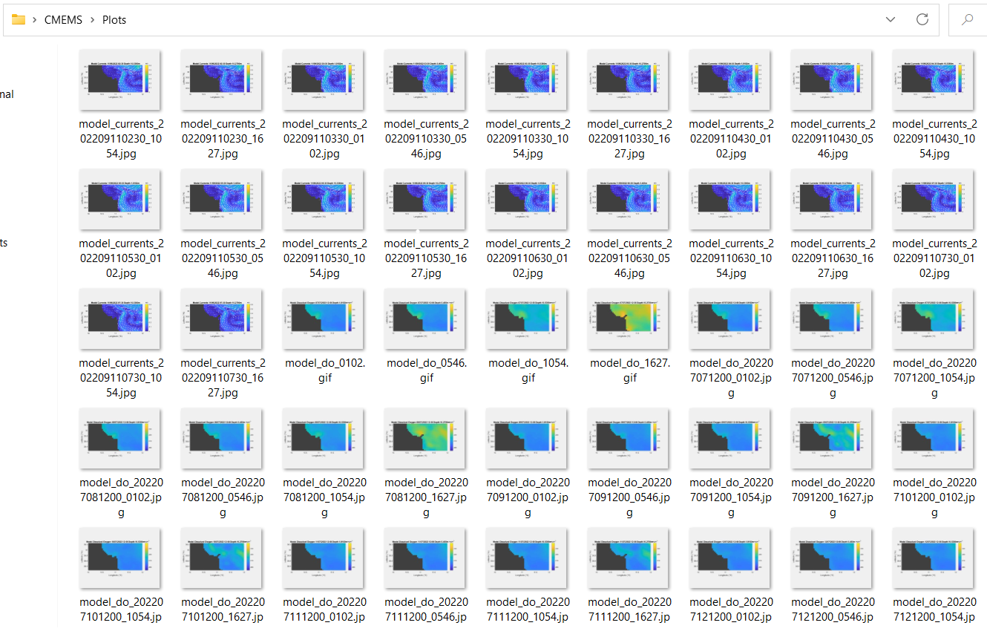
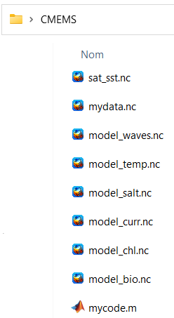

Slide 5
Matlab Script to download and plot the Data
cmdStr = ['python.exe "C:\Users\slimg\anaconda3\pkgs\motuclient-1.8.8-pyhd8ed1ab_0\site-packages\motuclient.py" --motu https://nrt.cmems-du.eu/motu-web/Motu --service-id ', serviceId, ' --product-id ', productId,' --longitude-min ', num2str(lonMin),' --longitude-max ', num2str(lonMax),' --latitude-min ', num2str(latMin),' --latitude-max ', num2str(latMax),' --date-min "', datestr(dateMin, 'yyyy-mm-dd 00:00:00'), '" --date-max "', datestr(dateMax, 'yyyy-mm-dd 00:00:00'), '" --variable analysed_sst --out-dir "', workingDir, '" --out-name "', productFile, '" --user "', username, '" --pwd "', password, '"'];
system(cmdStr)
!!! Consequently, I thought that it will be more straightforward to develop a code completely written in PYTHON, which have in addition the advantage to be Open-Source.

Slide 6
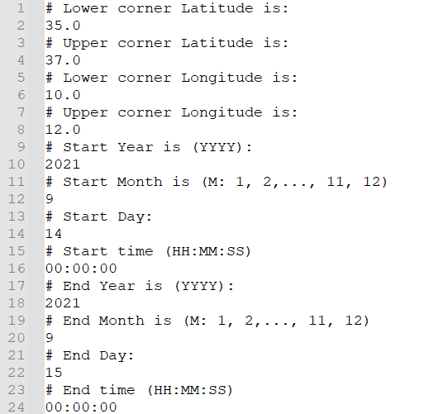
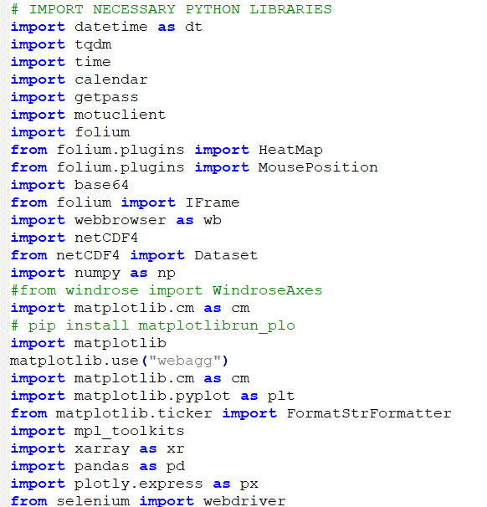
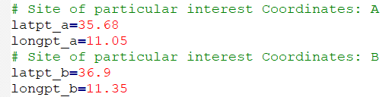
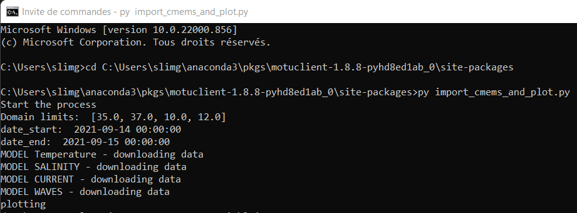
Parameters defined by the user in an external
txt file
RUN
on CMD

Slide 7
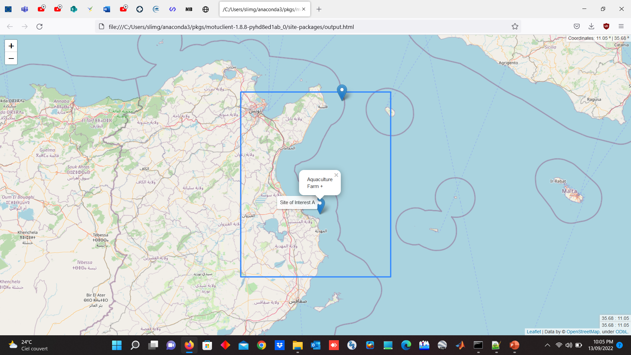
Wind Farm

Slide 8
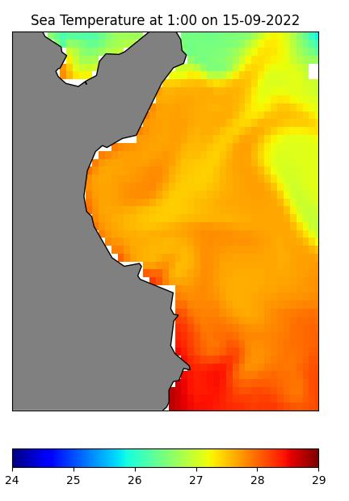
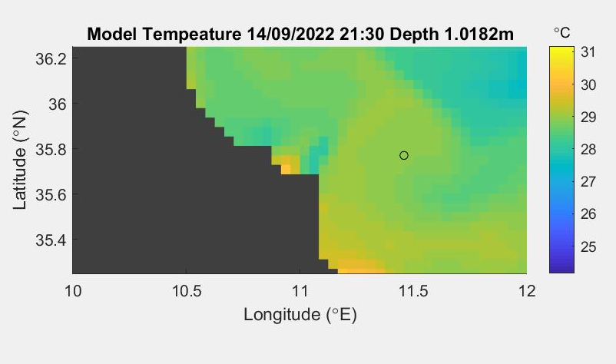

Slide 9
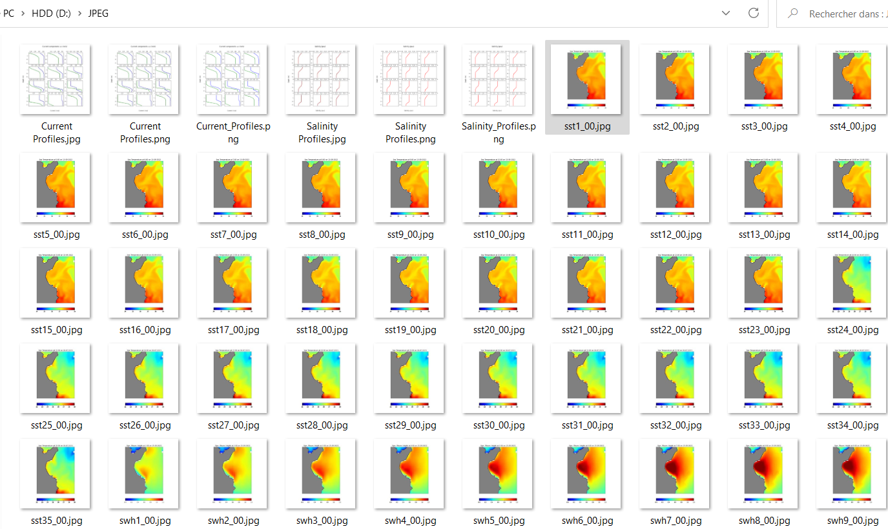

Slide 10
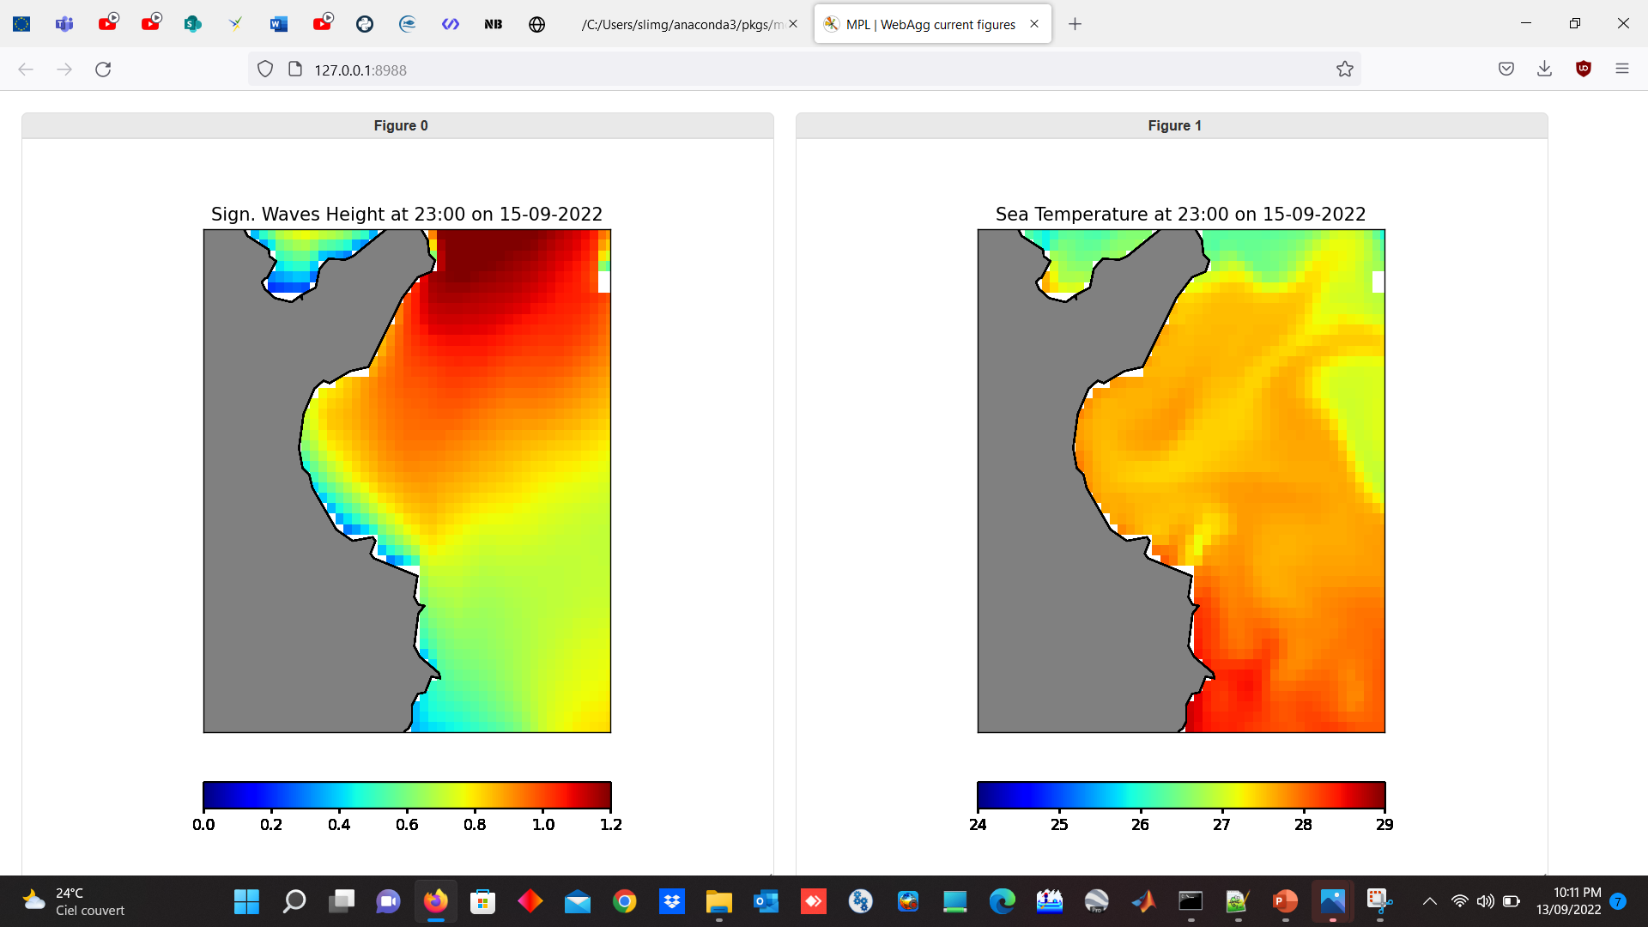

Slide 11
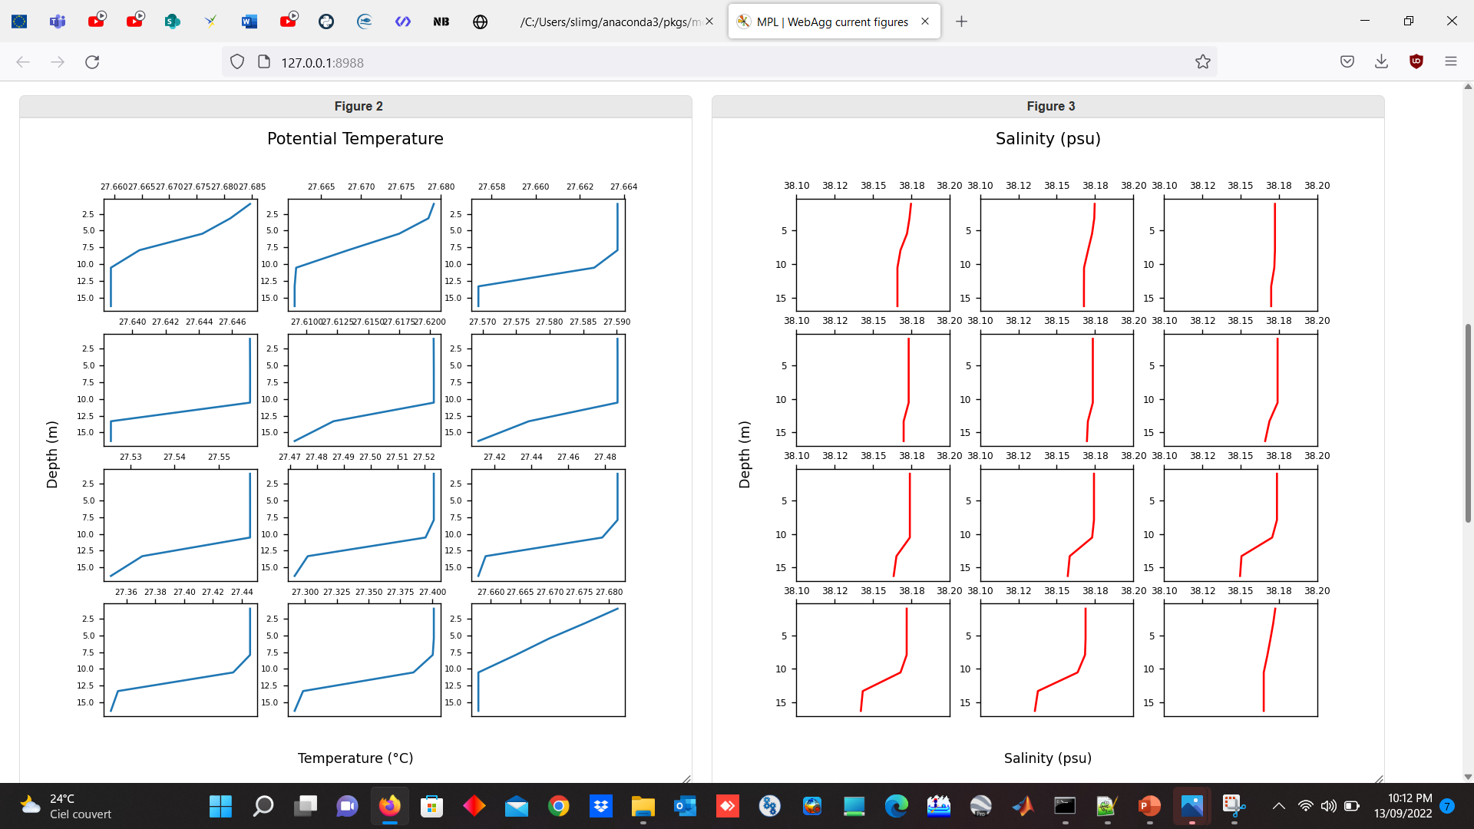

Slide 12
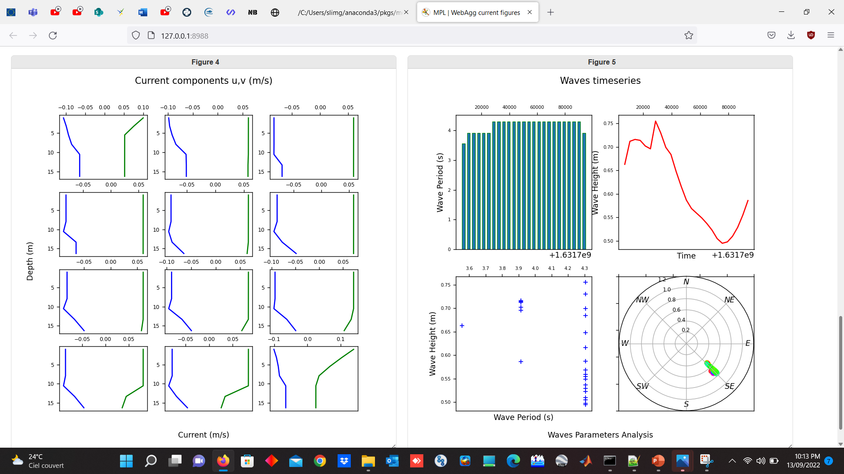

Slide 13
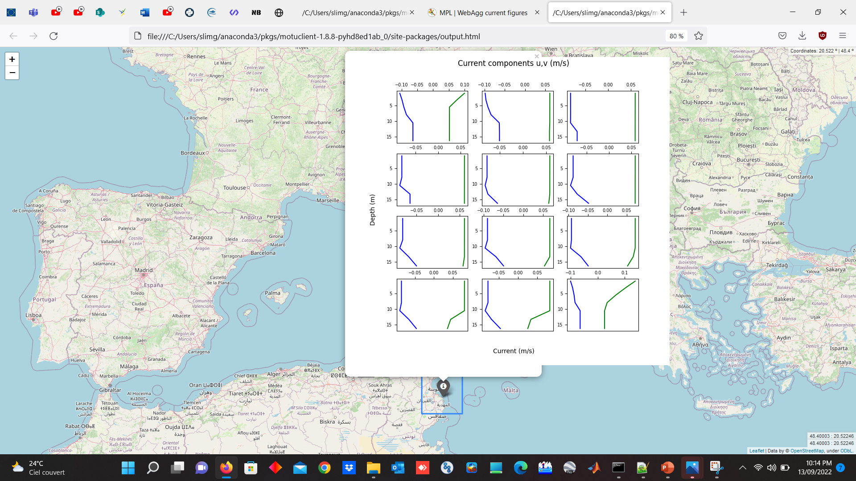

Slide 14
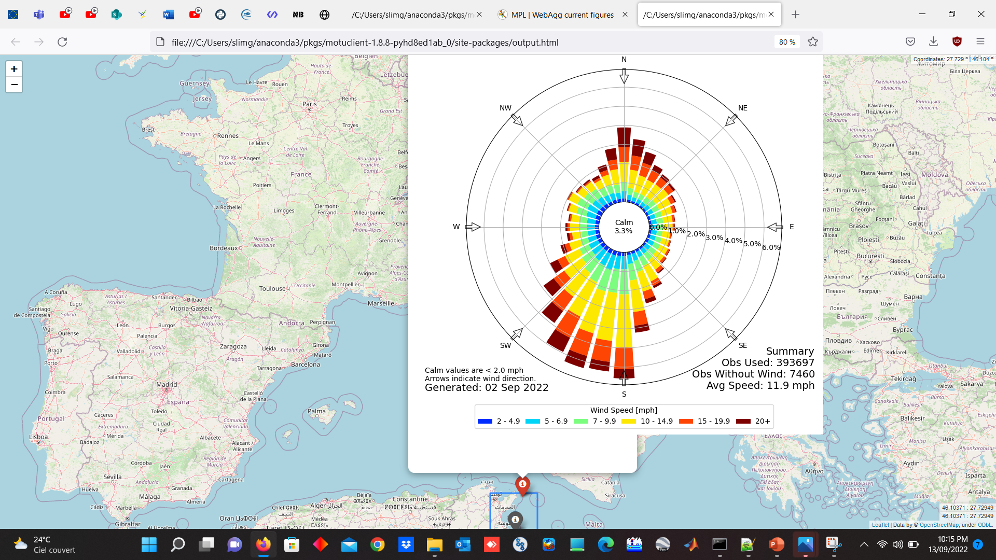

Slide 15
In the coming weeks or months, the aim is to:
Develop a Dashboard in which the end-users will be able to select:
- The area of interest
The sites of specific interest
The parameters to display
Some analytics depending on the business sector of the end-users for example:
    Quantity on food to be distributed in the fish-farm, which depends on water
    temperature
    Wind Power or wave Power for the sector of renewable offshore energies
    Other applications for harbors, O&G platforms, desalination plant, etc….

