Slide 1






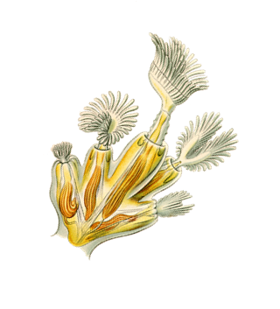
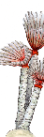
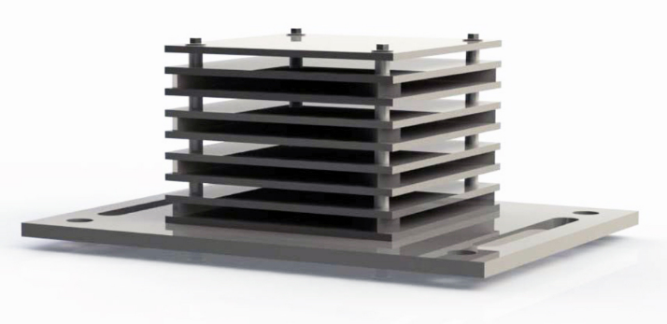


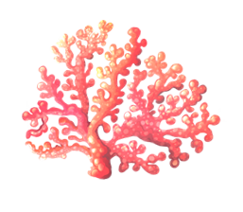
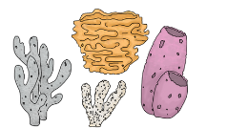


Standardised, quantifiable and non-destructive sampling of hard bottom communities using ARMS – Autonomous Reef Monitoring Structures
dr. Borut Mavrič, Ana Fortič, Aljoša Gračner, dr. Slavica Petović

Slide 2

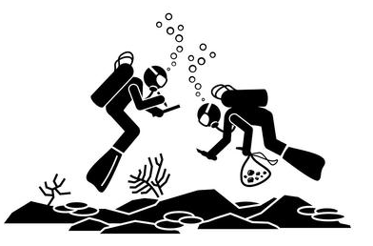
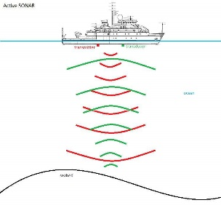

Monitoring approaches for hard bottom habitat types and communities
Data are lagging behind due to: physical properties,
              their structural complexity
                spatial heterogeneity
Several sampling methods: direct observations & sampling (comm. structure and condition)
remote sensing (habitat mapping)
artificial substrates

Slide 3


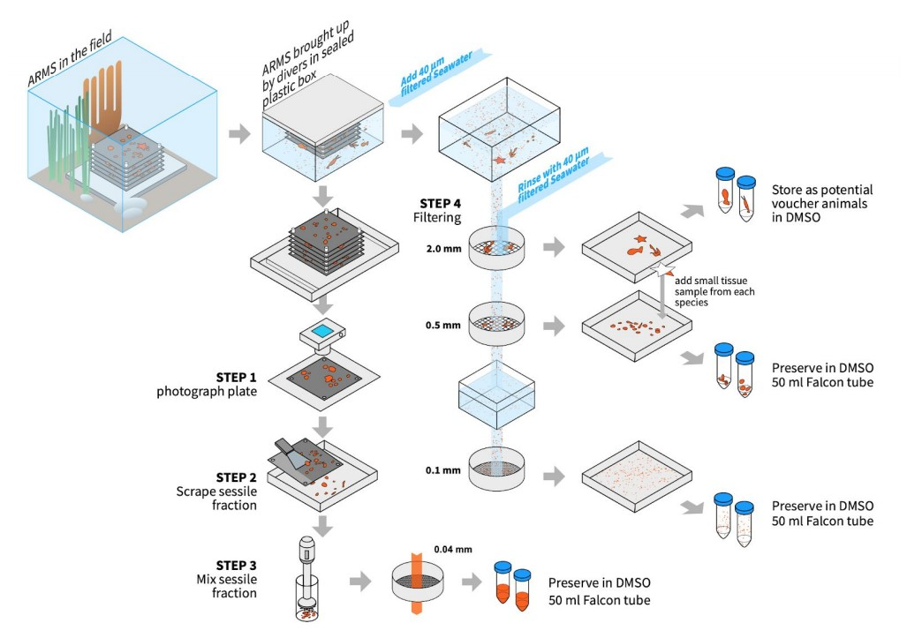
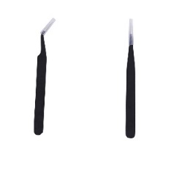

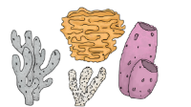





European ARMS programme (ARMS-MBON)
Long term – ARMS based observatories
(from: http://www.assembleplus.eu/research/ARMS-MBON, 2021)

Slide 4



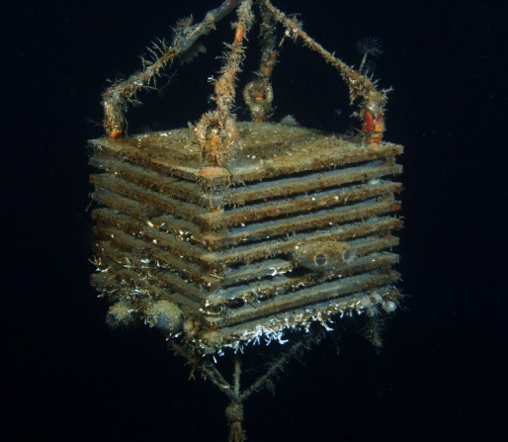
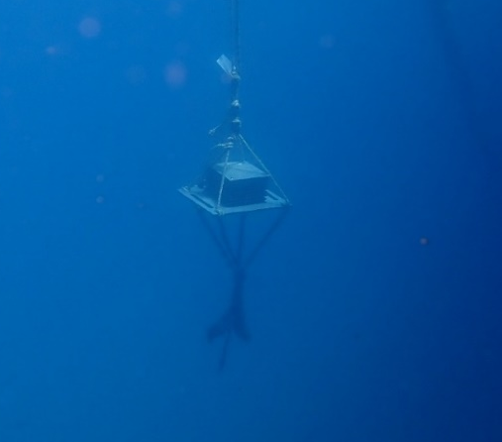
Testing of ARMS in the Adriatic Sea
Application of the method in ports/marinas
Port of Koper - SLO
Portomontenegro - MNE
BDV of fouling community and NIS
First trial in place since February 2021

Slide 5
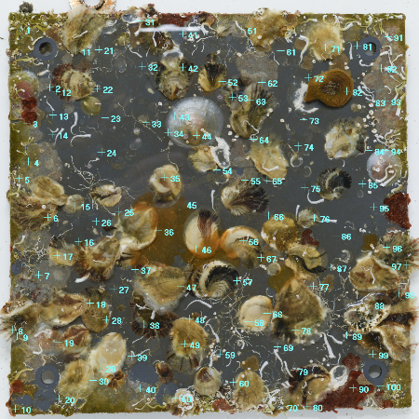
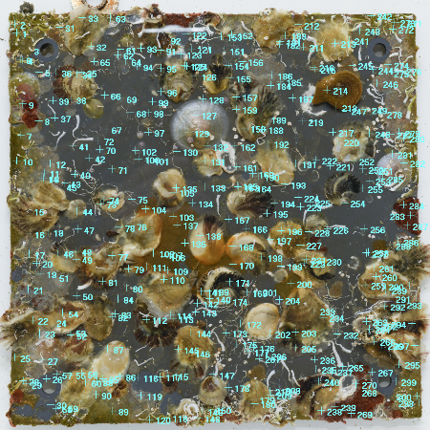
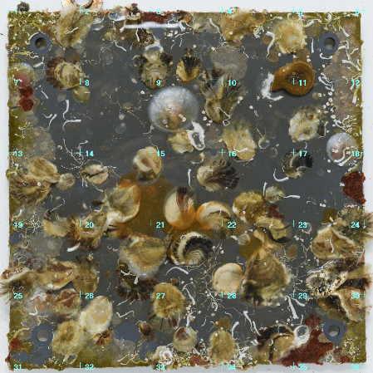

Testing of ARMS in the Adriatic Sea
Photo-analysis
100 point overlay
300 point overlay
5x5 grid survey
Stratified 10 x 10 grid
1 randomly assigned point per cell
Stratified 10 x 10 grid
3 randomly assigned points per cell
Uniform 5 x 5 grid
25 cells to be visually surveyed

Slide 6
Testing of ARMS in the Adriatic Sea
Photo-analysis
1. Number of detected taxonomic categories
2. Derived community structure
3. Time and effort

Slide 7
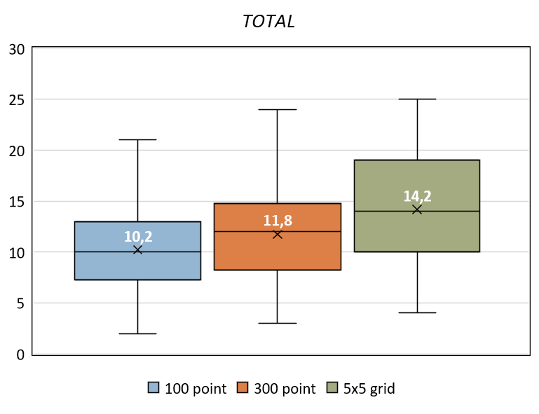
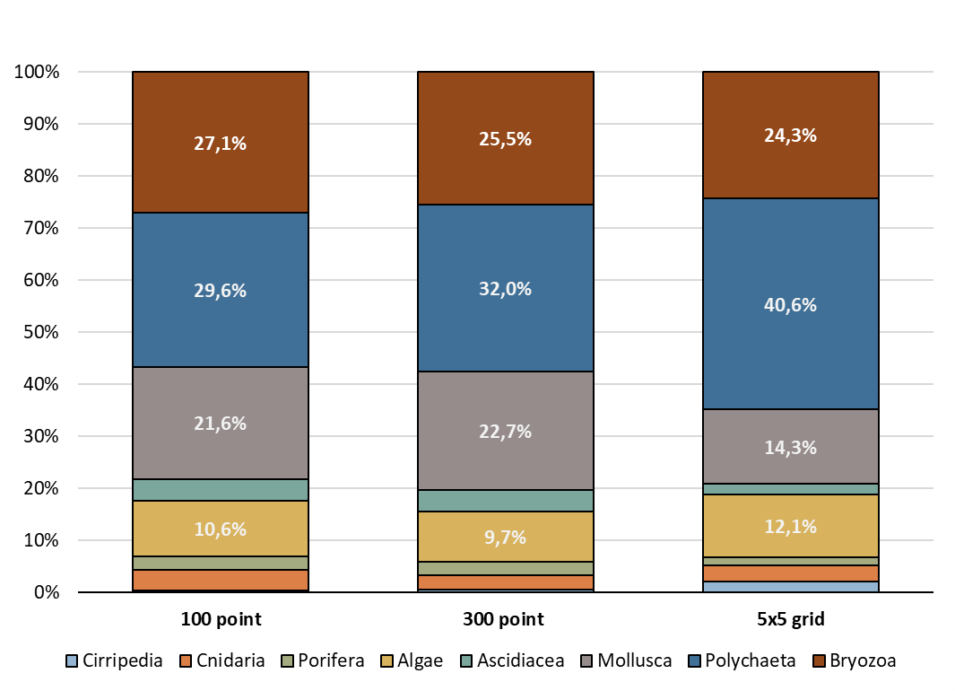
Testing of ARMS in the Adriatic Sea
5x5 grid method highest mean numbers of categories per plate-face
5x5 grid method highest total numbers of detected tax. categories
300 point method detected 2 more categories (overlooked by the 5x5 grid survey)
Proportions very similar among methods.
5x5 grid method slight alterations

Slide 8
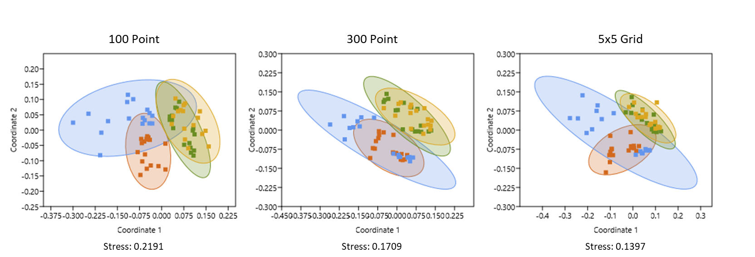
Testing of ARMS in the Adriatic Sea
300 point & 5x5 grid: similar and tighter scatter & better stress values.
300 point: nice separation among deployments.
100 point: most overlap, loosest scatter.

Slide 9
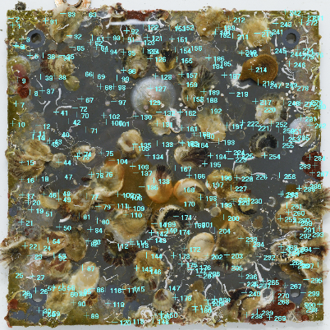

Testing of ARMS in the Adriatic Sea
300 point overlay
5x5 grid survey
Straightforward
Very rapid - CPCe automatization
Applied in previous studies
Sampling intensity - easily increased
Demanding & laborous
Slow - manual input
Sampling intensity - hard to increase
No information on empty proportions

Slide 10
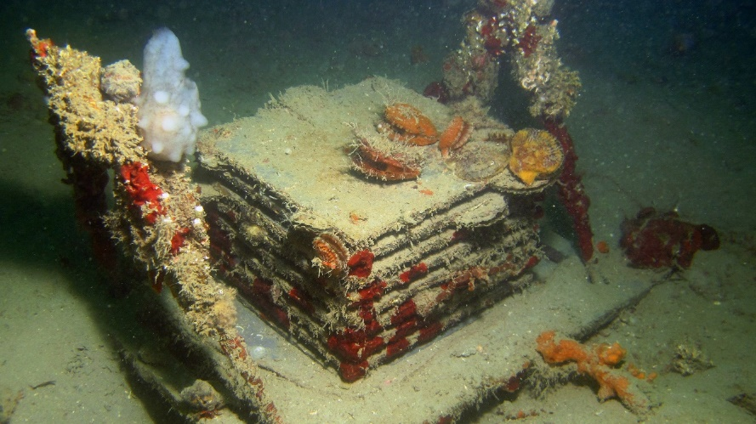
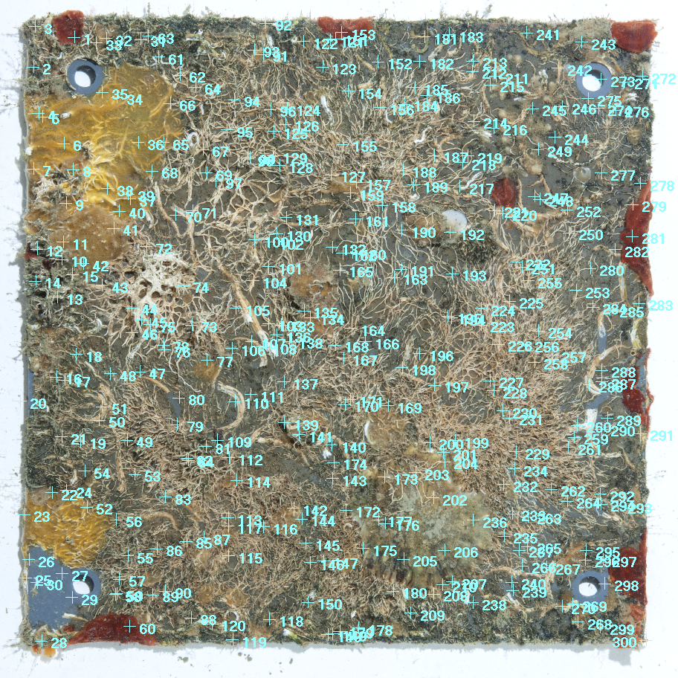
Conclusions
ARMS suitable colonization surfaces
Demanding organism identification
(juvenile, small, not developed, scarce literature)
  Photos of organisms around ARMS (morphological categories)
Coverage estimation: 300 point overlay (statistically robust, accurate and precise)
  Detects small changes in community structure
Computer annotation programmes essential
  Reduced time and effort
  (crucial for repeated monitoring tasks)

Slide 11
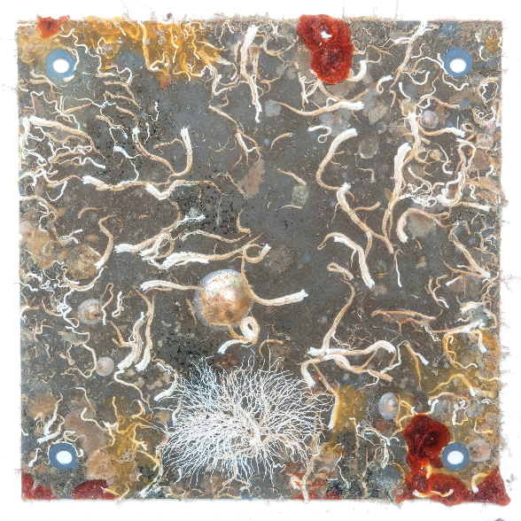
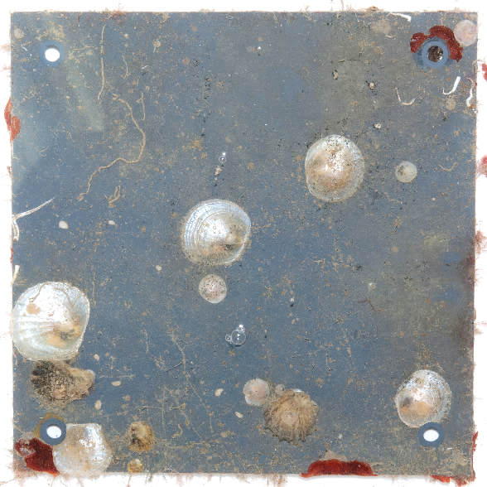
Conclusions
Effect of plate-face orientation:
(different environmental conditions)
  B plate-faces more colonized
  Larval preference → less sedimentation
Effect of available space:
  Colonization of edges & 1B plate-faces
  Exposure → more space, food, larval settlement
  Epifauna / Endofauna

Slide 12

HVALA!
Thank you for your attention!

