Slide 1
SHAREMED International workshop
Connecting marine research and boosting benefits to society
Malta, 13-14.9.2022
Towards an action plan on marine environmental threats and pollution
Presenting: Marina Lipizer, OGS
Contributions from: Lamma, CSIC, IPMA, OGS
And experts from IFREMER and CNR-IAS

Slide 2
Towards an action plan on marine environmental threats and pollution
Approach:
SHAREMED partnership consultation
Stakeholder consultation
Capitalization events
Experts consultation
… today discussion

Slide 3
Document outline:
What threats are currently being addressed and perceived as more important?
Focussing on pollution: what are the main needs in order to assess and address these threats?
What is the required approach to assess pollution in an effective and harmonized way
How to improve monitoring capabilities of south Mediterranean countries: compromise between innovative sensors-technologies and basic, easy/cheap to monitor parameters
Linking pressures and environment: what “ecological targets” should be monitored (at what spatial/temporal scales) to evaluate pollution impacts? Sentinel organisms? Common “targets” vs “local specific ones”? Can we set priorities?
With regards to the main drivers of environmental threats, what measures are required to reduce pollution at Mediterranean scale?
Governance aspects - What steps are needed to assess and address trans-boundary pollution

Slide 4
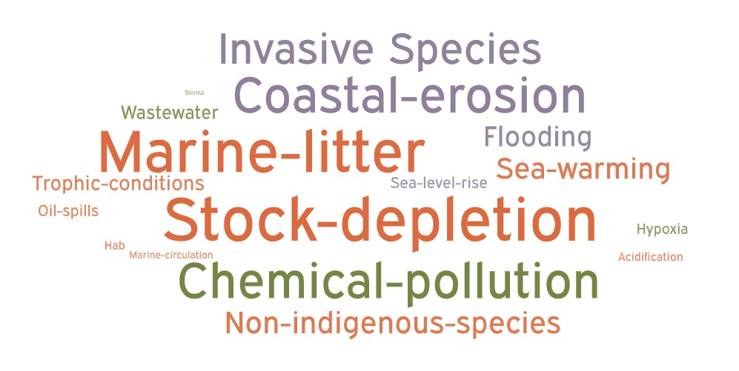
What threats are currently being addressed and perceived as more important?
Several approaches to involve different types of stakeholders (capitalization workshops at Mediterranean, national and local scale; online questionnaires; bilateral meetings; expert consultation)
Review of literature and of latest EU and global policies and frameworks

Slide 5
Focussing on pollution: what are the main needs in order to assess and address these threats?
“Milestone needs”
Agreement on:
monitoring objectives
key variables
monitoring design
assessment protocols
… towards harmonized monitoring and assessment
“Research needs”
Cause – effect response
New techniques (biomarkers, omics,…)
Pollution and GES, biodiversity,….
Cumulative effects (pollution + climate change)
…

Slide 6
What is the required approach to assess pollution in an effective and harmonized way
Requirements for observing system
Innovative technologies
Integrated use of multiple platforms (in situ, remote data, passive samplers,…)
Fast, reliable, cheap methods/sensors
Flexible and adaptive monitoring systems
Efficient data management to facilitate (timely) data access and interoperability
Common indicators and tools to support environmental assessment

Slide 7
How to improve monitoring capabilities of south Mediterranean countries: compromise between innovative sensors-technologies and basic, easy/cheap to monitor parameters
This topic needs further consultation
Some governance aspects were indicated:
Improve coordination and concrete benefits from integrated /joint monitoring programs considering existing surveys (mainly regional sea conventions RSCs and EU directives …)
Increase monitoring efficiency, serving multiple policy drivers, RSCs, EU directives and national requirement
Share monitoring platform infrastructures such as vessels, equipment, moorings, data, assessment procedures, experiences

Slide 8
Linking pressures and environment: what “ecological targets” should be monitored (at what spatial/temporal scales) to evaluate pollution impacts? Sentinel organisms? Common “targets” vs “local specific ones”? Can we set priorities?
Many gaps were identified in risks posed by pollutants on organisms and ecosystems
This topic needs further consultation and represents one of the major research priorities

Slide 9
Governance aspects - What steps are needed to assess and address trans-boundary pollution
Governance pillars to improve transboundary cooperation:
Strengthen synergies and avoid fragmentation by aligning objectives and harmonising agenda among different actors
Define governance architecture to ensure ownership, community feeling and transparency
Consolidate existing scientific networks, involving representatives of the users’ community, to better align with societal, governmental and economic requirements
Consolidate and promote consolidated observational and data sharing infrastructures (e.g. EMODnet, Copernicus, EuroGOOS, …)
Change approach: from current segmented projects to durable institutions and mandates

Slide 10
Regulatory aspects:
Ratification of Barcelona Convention Protocols
Alignment with the MSP which supports transnational cooperation through a framework for arbitrating between competing marine human activities and their impact on the marine environment
Geographical unbalance:
Integrated /joint monitoring programs considering existing surveys (mainly regional sea conventions RSCs and EU directives …)
Specific funding monitoring programs in non-European countries
Strengthen skills – capacity builiding

Slide 11
Proposed approach – contributing to SHAREMED framework document for a marine observation system of systems to assess and address environmental threats in the Mediterranean Sea
Set up of a Task Force at national level to identify emergent topics and priorities in research and monitoring activities
Set up of Joint Regional Groups – “Mediterranean agency” under Barcelona Convention umbrella: scientific and technical advisory working groups with the task to harmonise national priorities and to deliver a Common Strategy for Threats to Mediterranean.
Definition of a Memorandum of Understanding to reach international agreements on environmental priorities and on most efficient approaches to assess and address them
Regional Funding Programmes (under European Commission and under international frameworks)

Slide 12
Action plan is urgent!
Environmental threats are increasing and changing
In the case of pollution…. lot of knowledge and understanding in lacking (e.g. impacts, transfer mechanisms, modifications in the marine environment,…)
Sharing priorities is required to improve efficacy (assessment, management, reduction,,,)
Long term, yet flexible and adaptive monitoring is needed
Open, harmonized,validated, comparable data, interoperable infrastructures
Clear mandates and roles (who should do what)
Durable and dedicated funding
Capacity building
Capitalization and sharing of best practices

Slide 13
Thank you for you attention and for fruitful discussion
Marina Lipizer
​Istituto Nazionale di Oceanografia e di Geofisica Sperimentale - OGS
mlipizer@ogs.it

